Slide 1
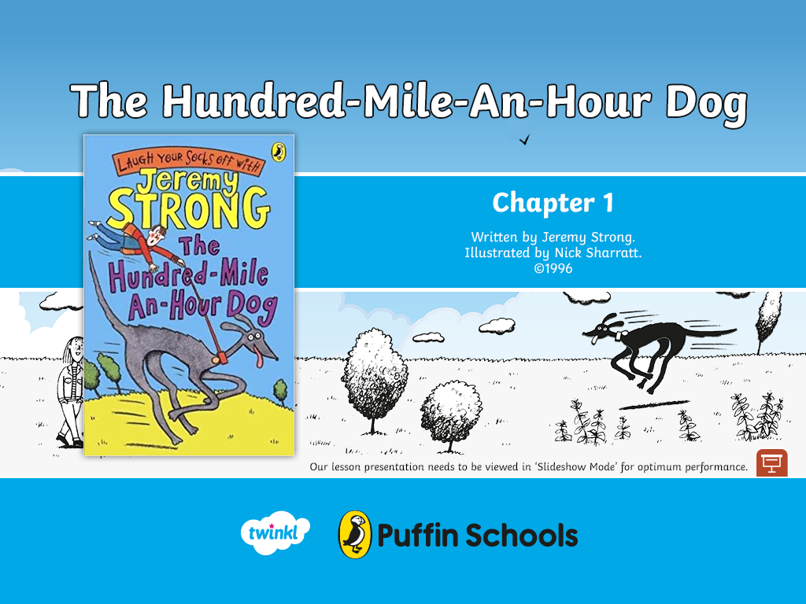

Slide 2




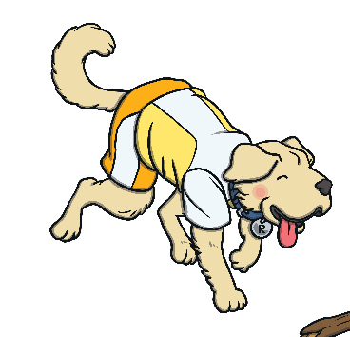
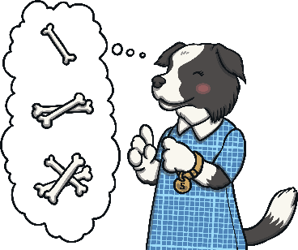





Puffin Book of the Week
The Hundred-Mile-An Hour Dog
The Hundred-Mile-An-Hour-Dog
Listen to Chapter 1
To listen to Jeremy Strong read the first chapter of
‘The Hundred-Mile-An-Hour Dog’, click here.
Next
When you’ve listened to Chapter 1, pause the video.
On the next slides, the Totally Pawsome Gang are going to
ask you some questions about what you’ve just heard.
Next
Text copyright ©1996 by Jeremy Strong; illustrations copyright ©1996 by Nick Sharratt

Slide 3


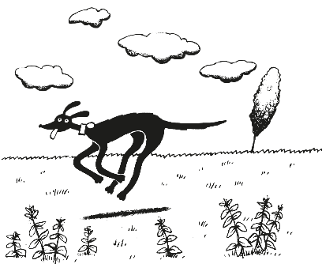


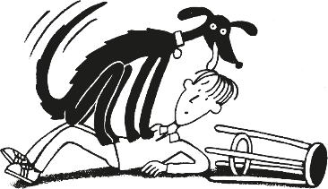
Puffin Book of the Week
The Hundred-Mile-An Hour Dog
The Hundred-Mile-An-Hour-Dog
To listen to the chapter again, click here.
Vocabulary Victor wants to know…
Can you think of two different words that can be used to describe Streaker?
You could have
used lots of different words to describe Streaker, such as fast, speedy or naughty.
Streaker is a mixed-up kind of dog. You can see from her thin body and powerful legs that she's got a lot of greyhound blood in her, along with quite a bit of Ferrari and a large chunk of whirlwind.
Reveal Answer
Back
Click here to read an extract from the book.
Next
Text copyright ©1996 by Jeremy Strong; illustrations copyright ©1996 by Nick Sharratt

Slide 4




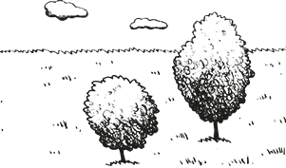
Puffin Book of the Week
The Hundred-Mile-An Hour Dog
The Hundred-Mile-An-Hour-Dog
To listen to the chapter again, click here.
Rex Retriever wants to know…
What does Trevor’s mum say that she will give him if he walks Streaker
every day?
Trevor’s mum says that she will give him thirty pounds if he walks Streaker every day.
'Trevor . . .' said Mum one morning at the beginning of the holiday, and she gave me one of her really big, innocent smiles. 'Trevor . . .' (I should have guessed she was up to something); 'Trevor - I'll give you thirty pounds if you walk Streaker every day this holiday.'
Reveal Answer
Back
Click here to read an extract from the book.
Next
Text copyright ©1996 by Jeremy Strong; illustrations copyright ©1996 by Nick Sharratt

Slide 5
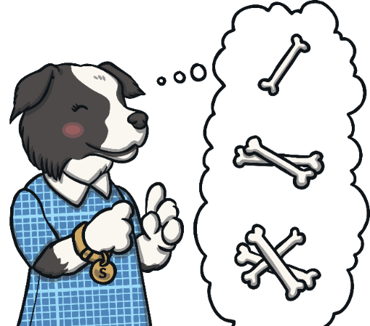
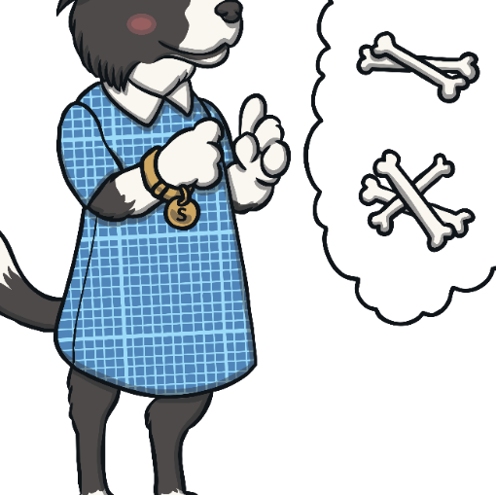


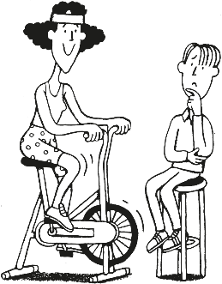
Puffin Book of the Week
The Hundred-Mile-An Hour Dog
The Hundred-Mile-An-Hour-Dog
To listen to the chapter again, click here.
Sequencing Suki wants to know…
Which of the following is the first thing that happens in this chapter?
Trevor asks his mum if he can have the money now.
or Trevor describes Streaker.
The first thing that happens in this chapter is that Trevor describes Streaker.
Streaker is a mixed-up kind of dog. You can see from her thin body and powerful legs that she's got a lot of greyhound blood in her, along with quite a bit of Ferrari and a large chunk of whirlwind.
Reveal Answer
Back
Click here to read the first paragraph from this chapter.
Next
Text copyright ©1996 by Jeremy Strong; illustrations copyright ©1996 by Nick Sharratt

Slide 6



Puffin Book of the Week
The Hundred-Mile-An Hour Dog
The Hundred-Mile-An-Hour-Dog
To listen to the chapter again, click here.
Inference Iggy wants to know…
Why do you think that Mum gives a strange squeak when Trevor agrees to walk Streaker?
Mum might have given a strange squeak because she was happy or because she was surprised.
Mum carried on quietly pedalling all this time. She must have known I'd give in. 'I'll do it,' I said. Mum gave a strange squeak and one of her feet slipped off a pedal. For some reason she looked even more pleased with herself than Streaker did.
Reveal Answer
Back
Click here to read an extract from the book.
Next
Text copyright ©1996 by Jeremy Strong; illustrations copyright ©1996 by Nick Sharratt

Slide 7

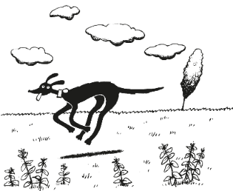


Puffin Book of the Week
The Hundred-Mile-An Hour Dog
The Hundred-Mile-An-Hour-Dog
To listen to the chapter again, click here.
Predicting Pip wants to know…
What do you think will happen in the next chapter?
There are lots of different answers that you could have given. You might have said that you think that Streaker will run away from Trevor when he tries to walk him.
Mum free-wheeled. 'At the end of the holiday, when the job is finished, I'll give you the money.' So that was that. I had agreed to walk the dog every day for two weeks, and that turned out to be only one of my problems that Easter. I must have been totally mad.
Reveal Answer
Back
Click here to read an extract from the book.
Finish
Text copyright ©1996 by Jeremy Strong; illustrations copyright ©1996 by Nick Sharratt

Slide 8

If you enjoyed reading The Hundred-Mile-An-Hour Dog, you can discover more at the Puffin Books website.

