Slide 2




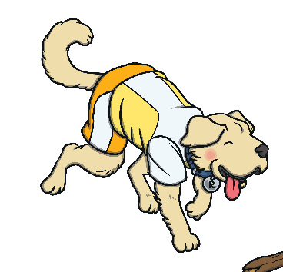
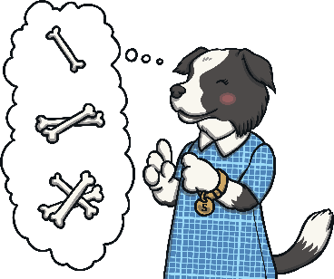





Puffin Book of the Week
The Hundred-Mile-An Hour Dog
The Hundred-Mile-An-Hour-Dog
Listen to Chapter 2
To listen to Jeremy Strong read the second chapter of
‘The Hundred-Mile-An-Hour Dog’, click here.
Chapter 2 starts at 4:02 minutes into the video.
Next
When you’ve listened to Chapter 2, pause the video.
On the next slides, the Totally Pawsome Gang are going
to ask you some questions about a picture from Chapter 2.
Next
Text copyright ©1996 by Jeremy Strong; illustrations copyright ©1996 by Nick Sharratt

Slide 3
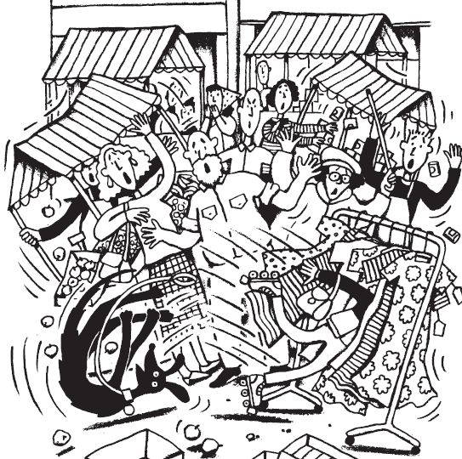


Puffin Book of the Week
The Hundred-Mile-An Hour Dog
The Hundred-Mile-An-Hour-Dog
To listen to the chapter again, click here.
Vocabulary Victor wants to know…
Which two adjectives could you use to describe how the people at the market might feel?
The two adjectives that
I could use to describe how the people at the market might feel are angry and startled.
Reveal Answer
Next
Text copyright ©1996 by Jeremy Strong; illustrations copyright ©1996 by Nick Sharratt

Slide 4
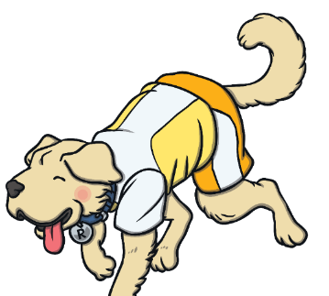
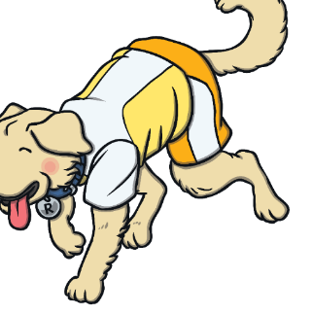
Puffin Book of the Week
The Hundred-Mile-An Hour Dog
The Hundred-Mile-An-Hour-Dog
To listen to the chapter again, click here.
Rex Retriever wants to know…
People from the market were chasing Trevor because they thought that he had stolen the old lady’s bag which was caught on his arm.
Why were the people from the market chasing
after Trevor?
Reveal Answer
Next
Text copyright ©1996 by Jeremy Strong; illustrations copyright ©1996 by Nick Sharratt

Slide 5
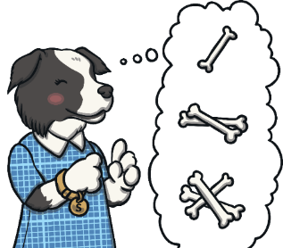
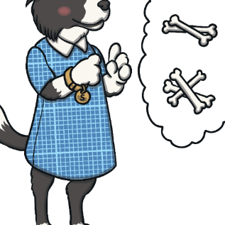
Puffin Book of the Week
The Hundred-Mile-An Hour Dog
The Hundred-Mile-An-Hour-Dog
To listen to the chapter again, click here.
Sequencing Suki wants to know…
How could you use 20 words or fewer to sum up what you can see in this picture?
In the picture, I can see Trevor letting go of Streaker’s lead and falling into a rack of dresses.
Reveal Answer
Next
Text copyright ©1996 by Jeremy Strong; illustrations copyright ©1996 by Nick Sharratt

Slide 6


Puffin Book of the Week
The Hundred-Mile-An Hour Dog
The Hundred-Mile-An-Hour-Dog
To listen to the chapter again, click here.
Inference Iggy wants to know…
What do you think the owner of the dress stall might be thinking?
The owner of the dress stall might be wondering why a boy has fallen into their stall and wondering where he came from.
Reveal Answer
Next
Text copyright ©1996 by Jeremy Strong; illustrations copyright ©1996 by Nick Sharratt

Slide 7


Puffin Book of the Week
The Hundred-Mile-An Hour Dog
The Hundred-Mile-An-Hour-Dog
To listen to the chapter again, click here.
Predicting Pip wants to know…
What do you think will happen at the market after Trevor and Streaker have left?
I think that the people who were following Trevor and Streaker through the market might stay and help all of the stallholders to tidy up the mess.
Reveal Answer
Finish
Text copyright ©1996 by Jeremy Strong; illustrations copyright ©1996 by Nick Sharratt

