Slide 1
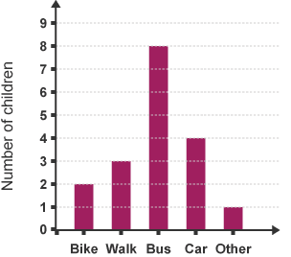
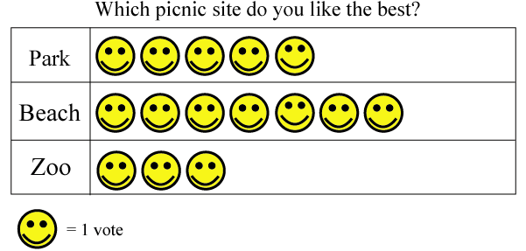
Summer 2: Week 5: Pre-Learning Task
The pre-learning task below could be used to assess pupils’ starting points within this objective. It needs to be completed by all/ or some of the pupils in advance of the main teaching.
Name |  | Summer 2: Week 5
Objective: Statistics | Solve 1-step and 2-step questions such as ‘How many more?’ and ‘How many fewer?’ using information presented in scaled bar charts pictograms and other graphs
The bar graph shows how children travel to school. How do most children get to school? ___________________________________ Do most people walk or come on a bike? ___________________________________ |  |  |  | A class was asked where they like picnicking. They had 3 choices. Which was the favourite destination for a picnic? _____________________ How many more preferred the park to the zoo? Why do you think the beach was so popular? __________________________ ___________________________________

Slide 2
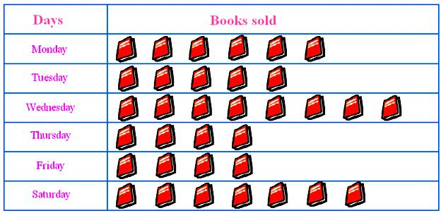
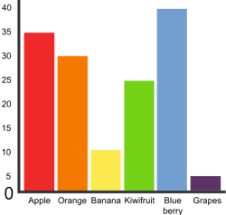
Summer 2: Week 5: Practice and Consolidation
Statistics: Solve 1-step and 2-step questions such as ‘How many more?’ and ‘How many fewer?’ using information presented in scaled bar charts pictograms and other graphs
Teaching Sequence | Oral and Mental Activities: Examples: | Pencil and Paper Activities Examples:
Solve problems using pictograms Solve problems using bar charts Solve problems using graphs Solve 1-step problems using pictograms, scaled bar charts and other graphs Solve 2-step problems using pictograms, scaled bar charts and other graphs Solve problems which ask, ‘How many more…?’ Solve problems which ask, ‘How many fewer…?’ | Collect information from the pupils about their favourite food; TV programme; leisure activity; holiday; etc. Create a pictogram and a bar chart with this information and use it to help pupils understand how information can be compiled and presented in different ways. Use a scaled system so pupils can see how large numbers can be accommodated within the graphs. Use example questions with the pupils and help them to create their own. Time permitted, let them collect their own information and create their own bar charts and then let them think of questions.
The pictogram shows how many books were sold on each day of a given week.
Study the pictogram and then answer these questions.
How many books were sold altogether during the week?
Why do you think most books were sold on Wednesday?
How many books were sold between Tuesday and Thursday?
This bar graph shows pupils’ favourite fruit in Year 5 in a school.
How many children favoured blueberries?
How many children favoured grapes?
Explain why it is good to set out information in this way.
Create your own bar graph of the favourite fruit of children in your class.

Slide 3
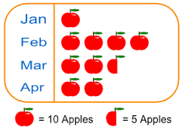
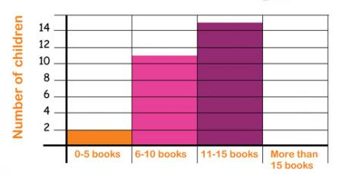
Summer 2: Week 5: Mastering this Objective – Deeper Understanding
Statistics: Solve 1-step and 2-step questions such as ‘How many more?’ and ‘How many fewer?’ using information presented in scaled bar charts pictograms and other graphs
Teaching Sequence | If pupils have mastered this objective they will be able to complete these activities independently:
Solve problems using pictograms Solve problems using bar charts Solve problems using graphs Solve 1-step problems using pictograms, scaled bar charts and other graphs Solve 2-step problems using pictograms, scaled bar charts and other graphs Solve problems which ask, ‘How many more…?’ Solve problems which ask, ‘How many fewer…?’ | This pictogram shows the average number of apples eaten by a family during the first four months of the year. On average, how many apples were eaten in March? On average, how many more apples were eaten in February compared with January? Create four questions you could ask about this pictogram. | This bar chart shows how many books pupils read during the summer term. How many pupils read between 11 and 15 books during the summer term? How many more pupils read between 6 to 10 books than read between 0 to 5 books during the summer term? Think of at least 5 more questions you could set for your friend in relation to this bar chart.

Slide 4
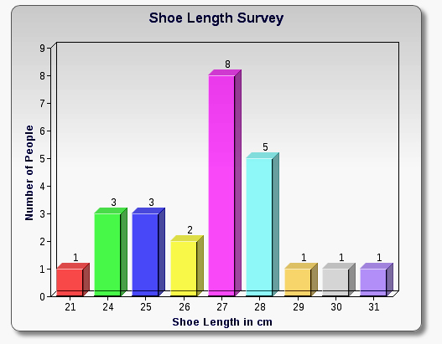
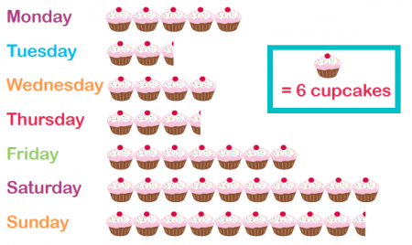
Summer 2: Week 5: Working at greater depth
Statistics: Solve 1-step and 2-step questions such as ‘How many more?’ and ‘How many fewer?’ using information presented in scaled bar charts pictograms and other graphs
Teaching Sequence | Activities for pupils working at greater depth:
Solve problems using pictograms Solve problems using bar charts Solve problems using graphs Solve 1-step problems using pictograms, scaled bar charts and other graphs Solve 2-step problems using pictograms, scaled bar charts and other graphs Solve problems which ask, ‘How many more…?’ Solve problems which ask, ‘How many fewer…?’ | This bar chart shows how many people have shoes of a certain length between 21 and 31 cm. Is it true that people with shoe length of 27 or 28 cm outnumber all the others in the survey? How would the bar graph be different if they had a category of 24cm or less and another category of 29cm or more? Think of 4 suitable questions to ask about this graph. | This pictogram shows how many cupcakes were sold from the local bakery in the local village during a given week. Why do you think most were sold on Saturday and Sunday? How many more were sold on Saturday and Sunday than on Monday and Tuesday? How many more cupcakes were sold on the most popular day compared with the least popular day? How else could you present this information? Think of at least 5 questions to ask your friend about this pictogram.

Slide 5
Summer 2: Week 5: Assessment
The grid below helps to identify the journey pupils make towards mastering this objective. It can be used by the teacher to keep an on-going check on progress or more likely placed in the pupils’ books so that they can keep their own checks.
Statistics: Solve 1-step and 2-step questions such as ‘How many more?’ and ‘How many fewer?’ using information presented in scaled bar charts pictograms and other graphs |  |  |  |  |  |  | Me | My Teacher
 | Can you solve ‘How many more’ or ‘How many fewer’ type questions in relation to a bar chart or a pictogram?
 |  | When given a bar chart are you able to create your own questions in relation to the information on it?
 |  |  | Can you read information from a bar chart, even when it is scaled?
 |  |  |  | Do you know the difference between a bar chart and a pictogram?
 |  |  |  |  | Can you read information from a pictogram even when it is scaled?
 |  |  |  |  |  | Do you understand how a pictogram works?

