Slide 1
Year 1: Summer 1
Week 6: Geometry – 2D and 3D Shapes
Recognise and name common 3D shapes, including: 3D. e.g. cuboids (including cubes), pyramids, spheres.

Slide 2
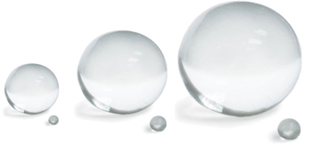
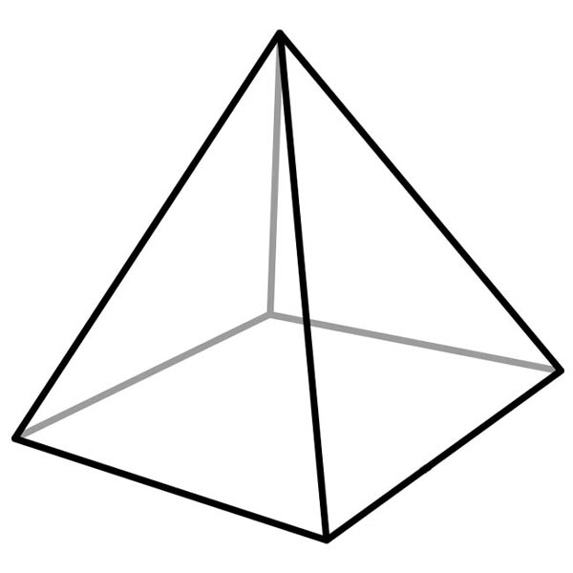
Summer 1: Week 6: Pre-Learning Task
The pre-learning task below could be used to assess pupils’ starting points within this objective. It needs to be completed by all/ or some of the pupils in advance of the main teaching.
Name |  | Summer 1: Week 6
Objective: Geometry 5 | Recognise and name common 3D shapes, including: 3D. e.g. cuboids (including cubes), pyramids, spheres.
What do you call these 2D shapes? |  |  | What do you call these 3D shapes?

Slide 3

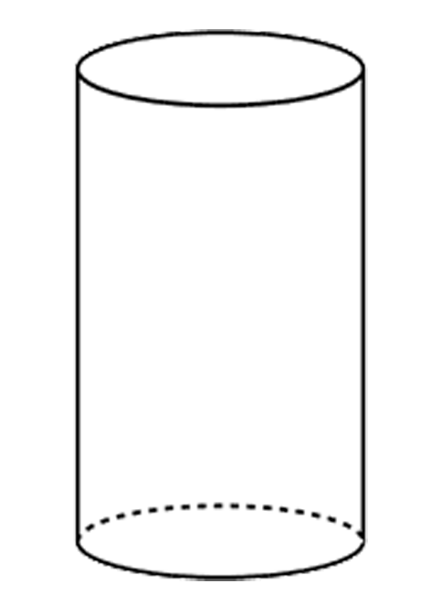
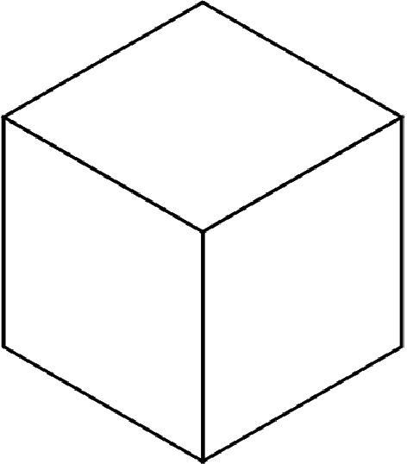

Summer 1: Week 6: Practice and Consolidation
Geometry: Recognise and name common 3D shapes, including: 3D. e.g. cuboids (including cubes), pyramids, spheres.
Teaching Sequence | Oral and Mental Activities Examples: | Pencil and Paper Activities Examples:
Start with reminder about names of 2D shapes Identify and name cubes Identify and name pyramids Identify and name spheres Identify and name cylinders | Reinforce previous learning about 2D and 3D shapes. Remind pupils of their properties by using apparatus. Talk about what various 3D shapes are used for, eg, what everyday use do we have for a sphere? Use a feely bag containing different 3D shapes. Let pupils know what the attribute of each shape is and get them to work out which shape the teacher is describing | Cuboids Find and record as many cuboids as they can find: In the classroom On the playground In their homes | Spheres and Cylinders Now do exactly the same with spheres and cylinders. Consider why the objects they have found need to be cuboids; spheres or cylinders.
 |  | Name the shapes and then complete these sequences:
 |  | Name the next shape in this sequence.

Slide 4

Summer 1: Week 6: Mastering this Objective – Deeper Understanding
Geometry: Recognise and name common 3D shapes, including: 3D. e.g. cuboids (including cubes), pyramids, spheres.
Teaching Sequence | If pupils have mastered this objective they will be able to complete these activities independently:
Start with reminder about names of 2D shapes Identify and name cubes Identify and name pyramids Identify and name spheres Identify and name cylinders
 | Use an ipad or camera to photograph as many of a given shape as you can in a given number of minutes, eg, 3 minutes Shapes should be: cube; cuboid; sphere; pyramid and cylinder. Create a record of the photographs. | Make a record of the 3D shapes found around them and the use of this shape:
What is the same and different about these 3 shapes?
Make a case for each of the 3 shapes being the odd one out.
3D Shape | Object | Use
Sphere
Cylinder | Drink can | Holds drink
Cuboid

Slide 5
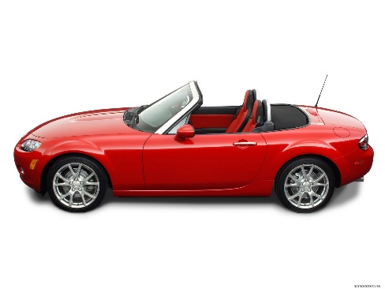

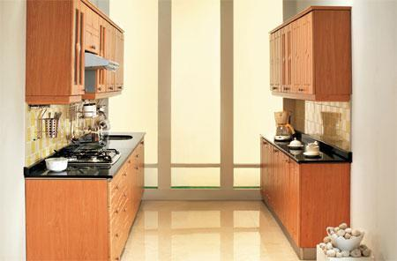
Summer 1: Week 6: Working at greater depth
Geometry: Recognise and name common 3D shapes, including: 3D. e.g. cuboids (including cubes), pyramids, spheres.
Teaching Sequence | Activities for pupils working at greater depth:
Start with reminder about names of 2D shapes Identify and name cubes Identify and name pyramids Identify and name spheres Identify and name cylinders | What shapes do the following tend to be: | Think of a car:
 | Draw a very interesting house using only: Triangles Circles Rectangles Squares Now give your partner a challenge to create another drawing.
Item of Object | Shape
Soft drink
Tennis Ball
Dice
Bar of Chocolate
Name any 2D or 3D shapes in a typical car.
Think of a bicycle:
Name as many 2D or 3D shapes you can see on a bicycle.
Your house should be made up of bricks; include 4 windows, roof, chimney and a door.
Think of your kitchen at home:
Name as many 2D or 3D shapes you can see in a your kitchen.

Slide 6
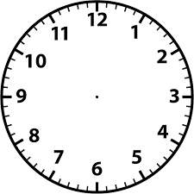
Summer 2: Week 1: Pre-Learning Task 1
The pre-learning task below could be used to assess pupils’ starting points within this objective. It needs to be completed by all/ or some of the pupils in advance of the main teaching.
Name |  | Summer 2: Week 1
Objective Measures: Time | Tell the time to the hour and half past the hour and draw the hands on a clock face to show these times.
Tell the time shown on the clock |  |  |  | Put the correct time on the clock
Six o’clock
Half past seven

Slide 7
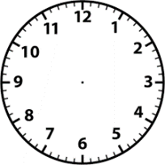
Summer 2: Week 1: Practice and Consolidation
Measures : Time: Tell the time to the hour and half past the hour and draw the hands on a clock face to show these times.
Teaching Sequence | Oral and Mental Activities Examples: | Pencil and Paper Activities Examples:
Tell o’clock times. Tell half past times. Draw hands on clock to show o’clock times. Draw hands on clock to show half past times. Know some key events associated with o’clock and half past times, e.g. lunchtime etc. | Using a clock face take pupils through what time it is when the big hand is at 12. Again, using the clock faces take pupils through what time it is when the big hand is at 6. Revise with pupils what they do at key times during the day, that is o’clock and half past the hour significant times, ie, lunch at 12 o’clock, go home at half past three, etc. | Time on the Clock face Work out what the time is on the following clock faces:
 |  | Put these times on the clock faces
4 o’clock
6 o’clock
Half past 12
Half past 7

Slide 8
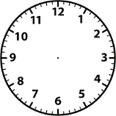
Summer 2: Week 1: Mastering this Objective – Deeper Understanding
Measures : Time: Tell the time to the hour and half past the hour and draw the hands on a clock face to show these times.
Teaching Sequence | If pupils have mastered this objective they will be able to complete these activities independently:
Tell o’clock times. Tell half past times. Draw hands on clock to show o’clock times. Draw hands on clock to show half past times. Know some key events associated with o’clock and half past times, e.g. lunchtime etc. | Rapid response to times shown on clock face Rapidly respond to times shown to them by an adult or their partner. The times need to be: o’clock, and half past the hour Swap roles with your partner. | Match the times to the words.
 | Mum is very busy and confused. She says she got out of bed at 12 o’clock had her lunch at 9 o’clock at night in the morning and finally sat down to watch television at 8 o’clock . What time did she get out of bed? _____________________________________ What time did she settle down to watch TV? _____________________________________
Half past one
Eight o’clock
Ten o’clock
Half past three
Got out of bed
Had lunch
Watched TV
Having worked out the correct times, put the hands on the clocks to show when the events really happened.

Slide 9
Summer 2: Week 1: Working at greater depth
Measures : Time: Tell the time to the hour and half past the hour and draw the hands on a clock face to show these times.
Teaching Sequence | Activities for pupils working at greater depth:
Tell o’clock times. Tell half past times. Draw hands on clock to show o’clock times. Draw hands on clock to show half past times. Know some key events associated with o’clock and half past times, e.g. lunchtime etc. | Ajmal leaves home to go the cinema at 5 o’clock, Helen leaves one hour later. Which of these clocks shows the time Helen left home? | Harry and his dad go to a football match at 2 o’clock. Hamid leaves to go to the same game half an hour after Harry. Theo and his sister Rachel leave half an hour before Harry. Match the people to times they left home: Harry half past one Hamid two o’clock Theo and Rachel half past two
These two clocks have had their minute hand broken off.
Work out what the time should be anyway.
Find clocks and watches and see if you can work out what the times are _ o’clock and half past – on real watches and clocks.

Slide 10
Summer 2: Week 1: Assessment
The grid below helps to identify the journey pupils make towards mastering this objective. It can be used by the teacher to keep an on-going check on progress or more likely placed in the pupils books so that they can keep their own checks.
Measures : Time: Tell the time to the hour and half past the hour and draw the hands on a clock face to show these times. |  |  |  |  |  | Me | My Teacher
 | Can you tell when it is half an hour before or half an hour after a given time to half past or o’clock?
 |  | Can you tell when it one hour before or one hour after a given time to o’clock or half past?
 |  |  | Can you tell when it is half past one through to half past twelve on a clock face?
 |  |  |  | Can you tell when it is one o’clock through to 12 o’clock on a clock face?
 |  |  |  |  | Can you explain what you might be doing at 10 o’clock in the morning and ten o’clock at night?

