Slide 1
Summer 1: Week 5: Pre-Learning Task
The pre-learning task below could be used to assess pupils’ starting points within this objective. It needs to be completed by all/ or some of the pupils in advance of the main teaching.
Name | Summer 1 Week 5
Objective: Geometry 4: Position and Direction | Consolidate: Describe position, direction and movement, including half, quarter and three-quarter turns and link to shapes
Work out the answers
Which shape is to the left of the circle? Which shape is above the moon? Which shape is below the square? Which shape is second from the left on the bottom row?
If the arrow makes half a turn, what will it look like?
A
If you start by facing A and make three-quarters of a turn to the right, which letter will you be facing?
D
B
C

Slide 2

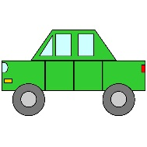

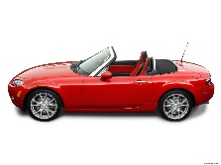
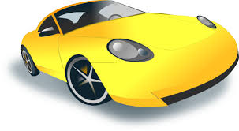
Summer 1: Week 5: Practice and Consolidation
Geometry: Consolidate: Describe position, direction and movement, including half, quarter and three-quarter turns and link to shapes
Teaching Sequence | Oral and Mental Activities Examples: | Pencil and Paper Activities Examples:
Use terms left and right in different contexts Remind them of moving bodies through full turns; half turns; quarter turns and three-quarter turns Use shape apparatus to show movements through these turns in practical setting Describe position, direction, movement using appropriate vocabulary | Revise turns: Pupils stand up and turn through half a turn and then a full turn. Pupils to revise turning a quarter turn to the left or to the right. Then, work on three quarter turns to the left and to the right. Ask questions about various objects being to the left or to the right. Use practical equipment set out in a circle around a person, get them to turn and see which object they face. | Using shapes: | Move each of these shapes through: Half a turn; A quarter turn to the left or to the right; A three-quarter turn What do they notice?
Betty faces the green car.
Which car will she face if she makes half a turn?
Which car will she face if she makes a quarter turn to the left?
What about half a turn to the right?

Slide 3
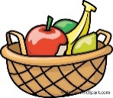
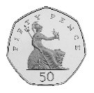
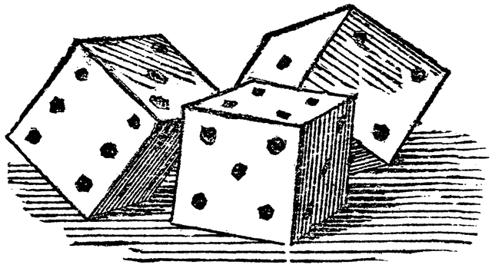



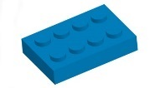

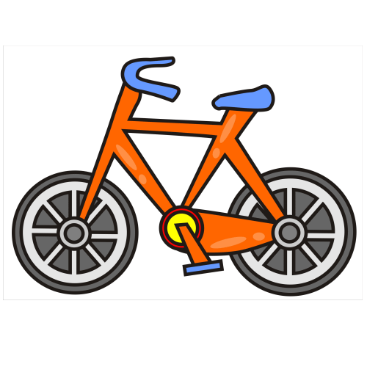


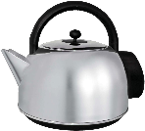


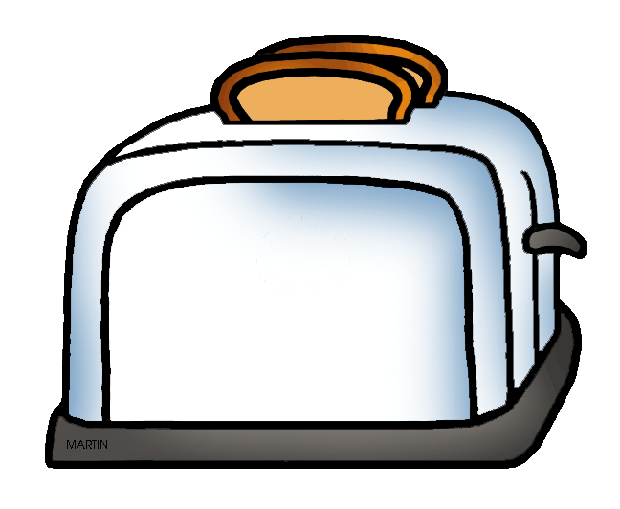
Summer 1: Week 5: Mastering this Objective – Deeper Understanding
Geometry: Consolidate: Describe position, direction and movement, including half, quarter and three-quarter turns and link to shapes
Teaching Sequence | If pupils have mastered this objective they will be able to complete these activities independently:
Use terms left and right in different contexts Remind them of moving bodies through full turns; half turns; quarter turns and three-quarter turns Use shape apparatus to show movements through these turns in practical setting Describe position, direction, movement using appropriate vocabulary | Identify the position of each object. Top, middle or bottom, first, second, third, fourth or fifth. To the left or right. On which row and column is the car: the football; and the fruit bowl.
 | N W E S | Associate the turns with North; East, South and West. Start by saying that someone is facing the North (or East, South or West). Then ask them to make a range of turns and record their outcomes.
On which row is:
The bicycle
The teddy
The toaster
The dice
Which column from the left is:
The lego brick
The book
The yogurt

Slide 4
Summer 1: Week 5: Working at Greater Depth
Geometry: Consolidate: Describe position, direction and movement, including half, quarter and three-quarter turns and link to shapes
Teaching Sequence | Activities for pupils working at greater depth:
Use terms left and right in different contexts Remind them of moving bodies through full turns; half turns; quarter turns and three-quarter turns Use shape apparatus to show movements through these turns in practical setting Describe position, direction, movement using appropriate vocabulary | Identify the position of each object. Top, middle or bottom, first, second, third, fourth or fifth. To the left or right.
 | Pupils to set up their own objects in a circle and invite pupils to go into the middle and then ask them to turn using the terms: quarter; half; full; three-quarters; left and right. | On the school playground or the school field, pupils mark out North, East, South and West. Pupils to instruct others to make turns. This time the pupils describe what they will see when they make a turn. The partner needs then to respond by saying that they turned a quarter to the left, etc.
Your partner thinks of an object from the grid.
You can ask your partner up to 4 questions, using the language above.
Your partner has to answer with a yes or no.

Slide 5
Summer 1: Week 5: Assessment (this re-enforces the learning carried out in Spring 2 Week 4)
The grid below helps to identify the journey pupils make towards mastering this objective. It can be used by the teacher to keep an on-going check on progress or more likely placed in the pupils books so that they can keep their own checks.
Geometry: Position and Direction: Describe position, direction and movement, including half, quarter and three-quarter turns |  |  |  |  |  |  |  |  | Me | My Teacher
 | Can you use the terms ‘to the left of..’ or ‘to the right of…’ accurately?
 |  | Can you use the terms behind, in front of, and in between accurately?
 |  |  | Can you turn to the right or left?
 |  |  |  | Can you hold out your right or left hand?
 |  |  |  |  | Can you turn your body through three-quarters of a turn?
 |  |  |  |  |  | Can you turn your body through a quarter of a turn?
 |  |  |  |  |  |  | Can you turn your body through half a turn?
 |  |  |  |  |  |  |  | Can you turn your body through one full turn?

