Slide 1
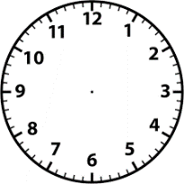
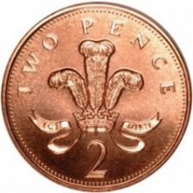
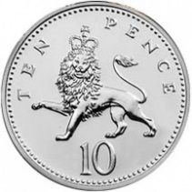
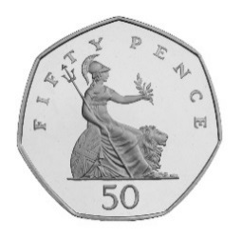
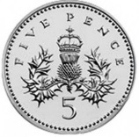
Summer 2: Week 4: Measures
The pre-learning task below could be used to assess pupils’ starting points within this objective. It needs to be completed by all/ or some of the pupils in advance of the main teaching.
Name |  | Summer 2: Week 4: Only needs to be used with pupils who you feel are insecure with this unit of learning
Objective | Consolidate: All learning involving length; weight and mass; capacity and volume; time and money
Name 3 things that are longer than 1 metre. _______________________________ |  |  |  | Name 3 things that are shorter than 1 metre. _______________________________
Name 3 things that weigh more than 1Kg. _______________________________ |  |  |  | Name 3 things that weigh less than 1Kg. _______________________________
+ + + =
The clock should say half past two.
Place the hands on the clock to show the time.
What is the time?
_____________________

Slide 2
Summer 2: Week 4: Practice and Consolidation
Measures: General: Consolidate: All learning involving length; weight and mass; capacity and volume; time and money
Teaching Sequence | Oral and Mental Activities Examples: | Pencil and Paper Activities Examples:
Revise all aspects of learning associated with measurement in Year 1 | Revise and consolidate Pupils’ understanding of length by focusing on longer and shorter than a metre and reminding pupils about the term centimetre; Pupils understanding of weight and mass by focusing on heavier and lighter than a Kg and reminding pupils about the term grams; Pupils understanding of capacity and volume by focusing on full, half full and empty. Remind pupils of the terms litre and millilitres; Pupils’ knowledge of money by focusing on different coins; Pupils’ knowledge of and understanding of time by focusing on o’clock and half past the hour; | Take all the coins from 1p to £2 and put them in order according to their value. Take a 10p coin and ask pupils to give equivalent amounts using other coins. Now do the same with 50p, £1 and £2. Record accordingly. | Use clock faces to check pupils’ knowledge of time to o’clock and to half past the hour. Use the clock faces to check on pupils understanding of one hour and half an hour earlier and later.
 |  | Make a list of items that measure more or less than a metre. Now, do the same with items measuring between 1m and 5m, Now a list of items that weigh more than 1Kg. Then more than 5Kg. | Find as many items as they can which hold 1 litre. Now, find containers which hold more than 5 litres. Check if pupils are confident in explaining the difference between capacity and volume

Slide 3

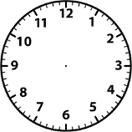
Summer 2: Week 4: Mastering this Objective – Deeper Understanding
Measures: General: Consolidate: All learning involving length; weight and mass; capacity and volume; time and money
Teaching Sequence | If pupils have mastered this objective they will be able to complete these activities independently:
Revise all aspects of learning associated with measurement in Year 1 |  | James has 2 different copper coins. What is the smallest amount he could have? What is the most that he could have? What is the smallest and the most he could have if the 2 coins do not have to be different?
 | Compare a number of objects, up to 5, and use the terminology of ‘weighs more than’ and ‘weighs less than’. Firstly, estimate. Then, check using balances or weighing scales Then, record findings.
Using the terms:
longer
longest
shorter
shortest, and
the same as
Make up as many sentence about the girls’ hair as you can.
Put the hands on the clock:
I got up at half past seven;
I had my lunch at half past twelve
I got home after school at four o’clock

Slide 4
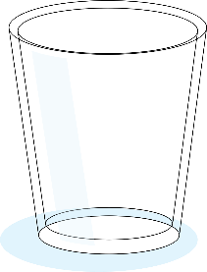
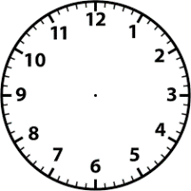
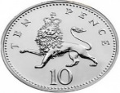
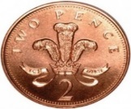
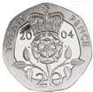
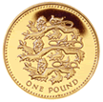

Summer 2: Week 4: Working at greater depth
Measures: General: Consolidate: All learning involving length; weight and mass; capacity and volume; time and money
Teaching Sequence | Activities for pupils working at greater depth:
Revise all aspects of learning associated with measurement in Year 1 | If Glass B holds twice as much as Glass A and Glass C holds twice as much as Glass B, will a full Glass A and a full Glass B fill Glass C? Explain your answer. | A film which lasts 1 and a half hours finishes at nine o’clock. What time did it start? Put the times on these two clock faces:
 | Frankie empties his pocket and has the following coins:
A
B
C
Film starts Film finishes
Has Frankie enough to go to the cinema which cost £1.50p?
Can he pay someone exactly 75p without needing change?
He has to give his mum £1.25 How can he do this?

