Slide 1
Summer 2: Week 3: Addition and Subtraction
The pre-learning task below could be used to assess pupils’ starting points within this objective. It needs to be completed by all/ or some of the pupils in advance of the main teaching.
Name |  | Summer 2: Week 3: Only needs to be used with pupils who you feel are insecure with this unit of learning
Objective | Add and subtract 1-digit and 2-digit numbers to 20 including 0
Can you add these numbers together? |  |  |  | Can you subtract these numbers?
7 + 5 |  |  |  | 17 - 5
9 + 6 |  |  |  | 18 - 3
7 + 8 |  |  |  | 16 - 14
12 + 8 |  |  |  | 19 - 9
Can you add these together: 0 + 8 =
Can you subtract 0 from 15?

Slide 2
Summer 2: Week 3: Practice and Consolidation
Addition and Subtraction: Add and subtract 1-digit and 2-digit numbers to 20 including 0
Teaching Sequence | Oral and Mental Activities Examples: | Pencil and Paper Activities Examples:
Record in writing: Add two 1-digit numbers to ten. Add two 1-digit numbers to 18. Add two numbers that equal any number up to 20, including zero. Subtract two 1-digit numbers. Subtract a 1-digit number from a 2-digit number up to 20. Subtract a 2-digit number from a 2-digit number up to 20. | Revise and consolidate Check pupils’ response to adding mentally any two 1-digit numbers. Now work adding 10 to a 1-digit number, doing so rapidly. Talk about and practise adding nine to any 1-digit number. Check pupils’ response to subtracting one 1-digit number from another, then a subtract a 1-digit number from a 2-digit number to 20. Talk about how to take 9 from a 2-digit number to 20. | Six children took part in a dancing competition. Maria was awarded 9 marks, Moshin was awarded 7 marks; Thomas was awarded 6 marks; Helen was awarded 8 marks; Emma was awarded 10 marks; Hannah was awarded 5 marks; How many marks did they get altogether? | Put a circle around each calculation with the answer 9. 5 + 3 15 – 6 13 + 6 12 - 3 12 – 4 12 + 3 5 +2 + 2 4 + 2 + 3 19 – 10 17 – 8 20 – 11 7 + 2
 |  | Temperature Check The temperature in Spain was 20 degrees in the morning and 9 degrees colder in the evening. What was the temperature in the evening? What would the evening temperature be if it fell by 6 degrees? | Coins in the bowl A bowl contains 12 silver coins and 7 gold coins. Sade takes 7 silver coins and 3 gold coins. Helen takes 3 silver coins and 2 gold coins. How many silver coins are there left in the bowl? Which girl has most gold coins?

Slide 3
Summer 2: Week 3: Mastering this Objective – Deeper Understanding
Addition and Subtraction: Add and subtract 1-digit and 2-digit numbers to 20 including 0
Teaching Sequence | If pupils have mastered this objective they will be able to complete these activities independently:
Record in writing: Add two 1-digit numbers to ten. Add two 1-digit numbers to 18. Add two numbers that equal any number up to 20, including zero. Subtract two 1-digit numbers. Subtract a 1-digit number from a 2-digit number up to 20. Subtract a 2-digit number from a 2-digit number up to 20. | Pick a pair of numbers. Take the larger number away from the smaller one. Write the numbers and the answers. Now pick a different pair and write the numbers and the answers. Keep doing this and find out how many possible answers you can get. You can do this again with 4 different numbers – all between 0 and 20 | Throw balls into a bucket Change the numbers on the buckets but do not go beyond 9. Now ask your partner what the total can be if they score with all 5 balls.
 |  | What do you notice about the following? 19 - 3 = 16 20 – 12 = 8 19 -16 = 3 20 – 8 = 12 Make similar number sentences.
Take away
15
7
9
17
Harry has 5 balls. If he scores with each ball:
Can he score 20?: Can he score 17?;
Can he score 21?; Can he score 4?

Slide 4
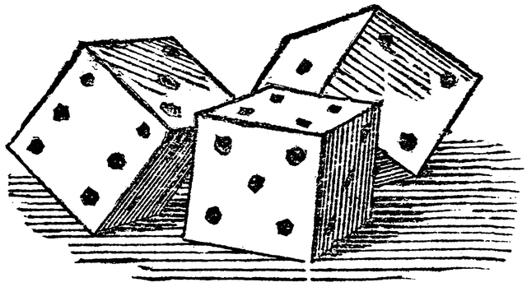
Summer 2: Week 3: Working at greater depth
Addition and Subtraction: Add and subtract 1-digit and 2-digit numbers to 20 including 0
Teaching Sequence | Activities for pupils working at greater depth:
Record in writing: Add two 1-digit numbers to ten. Add two 1-digit numbers to 18. Add two numbers that equal any number up to 20, including zero. Subtract two 1-digit numbers. Subtract a 1-digit number from a 2-digit number up to 20. Subtract a 2-digit number from a 2-digit number up to 20. | Lucy has been given 15 monster munchies for her birthday. She has three friends who have 17 monster munchies between them. Share them out equally between them. Explain your answer. | Addition Triangle What numbers are missing from the squares inside the triangle?
 | I have 3 dice (1 to 6). Show four ways I can lay out the dice so that the numbers on top add up to 12.
 | Now make your own.
 |  | Take 10 away from 18, and then add 3 to your answer. How many have you now? Take 12 away from 19, and then add 7 to your answer. How many have you now?
17
13
14
4
5
4
Choose a number between 0 and 9 to go into the empty circles so that each line adds up to 19
5
6

Slide 5
Summer 2: Week 3: Assessment This is exactly the same as the Summer 1 Week 2 unit of learning
The grid below helps to identify the journey pupils make towards mastering this objective. It can be used by the teacher to keep an on-going check on progress or more likely placed in the pupils books so that they can keep their own checks.
Addition and Subtraction: Add and subtract 1-digit and 2-digit numbers to 20 including 0 |  |  |  |  |  | Me | My Teacher
 | Can you subtract a 1-digit number from a 2-digit number?
 |  | Can you subtract two, 1-digit numbers?
 |  |  | Can you add a 1-digit number to a 2-digit number to 20?
 |  |  |  | Can you add two, 1-digit numbers to 20?
 |  |  |  |  | Can you add two, 1-digit numbers to 10?

