Slide 1
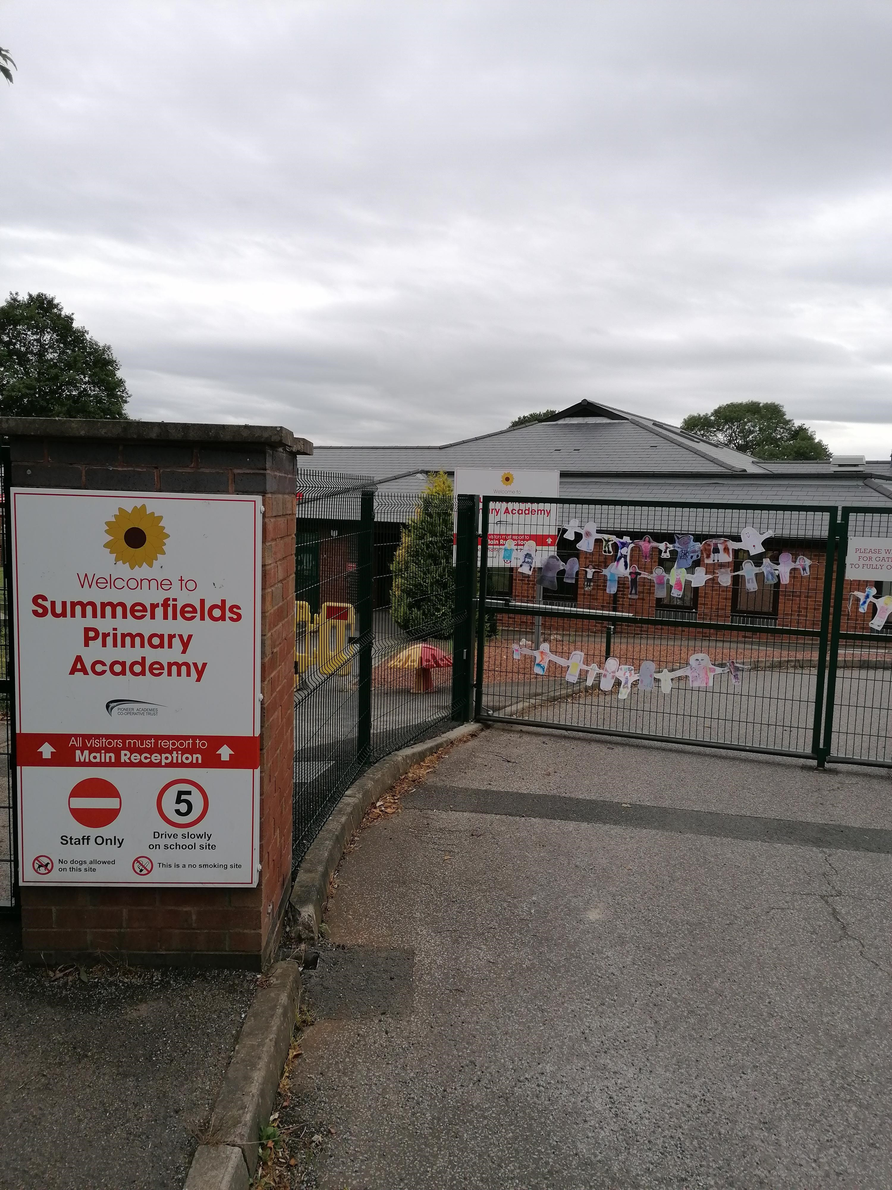

Y1 – North America – Group A
I am going back to school!

Slide 2


We have all been staying at home to keep everyone safe.
Some children have enjoyed being at home :)
Some children have been bored at home :(

Slide 3
I will go back to school Tuesday 9th June.
I will start school at 8.45AM and finish at 2.45pm.
I will enter school through the main FRONT GATE (HAIGH CROFT) AND LEAVE THROUGH THE BOTTOM GATE ONTO CEDAR CLOSE.
When my parents / when i arrive at school, enter through the MAIN FRONT GATE and enter the KS1 Playground, following the 1 way system in the playground. CHILDREN ONLY TO WALK THROUGH THE KS1 DOOR AND ENTER Mrs. Haynes’ classroom. PARENTS WILL CONTINUE THROUGH THE PLAYGROUND, LEAVING VIA THE CEDAR CLOSE GATE.
As we walk around outside, we will make sure we stay away from other families and children.
We can smile, wave and say hello, but we can’t hug each other!

Slide 4
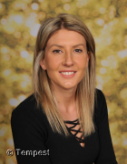
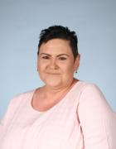
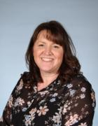
I will go into MRS. HAYNES’ classroom door.
My teachers will be Mrs. haynes, mrs. yates & Mrs. Harris.
We won’t all rush into the classroom.
We will take it in turns so we don’t bump into other families / children.
Only children and staff can go into the building so I will say goodbye to my family outside.

Slide 5
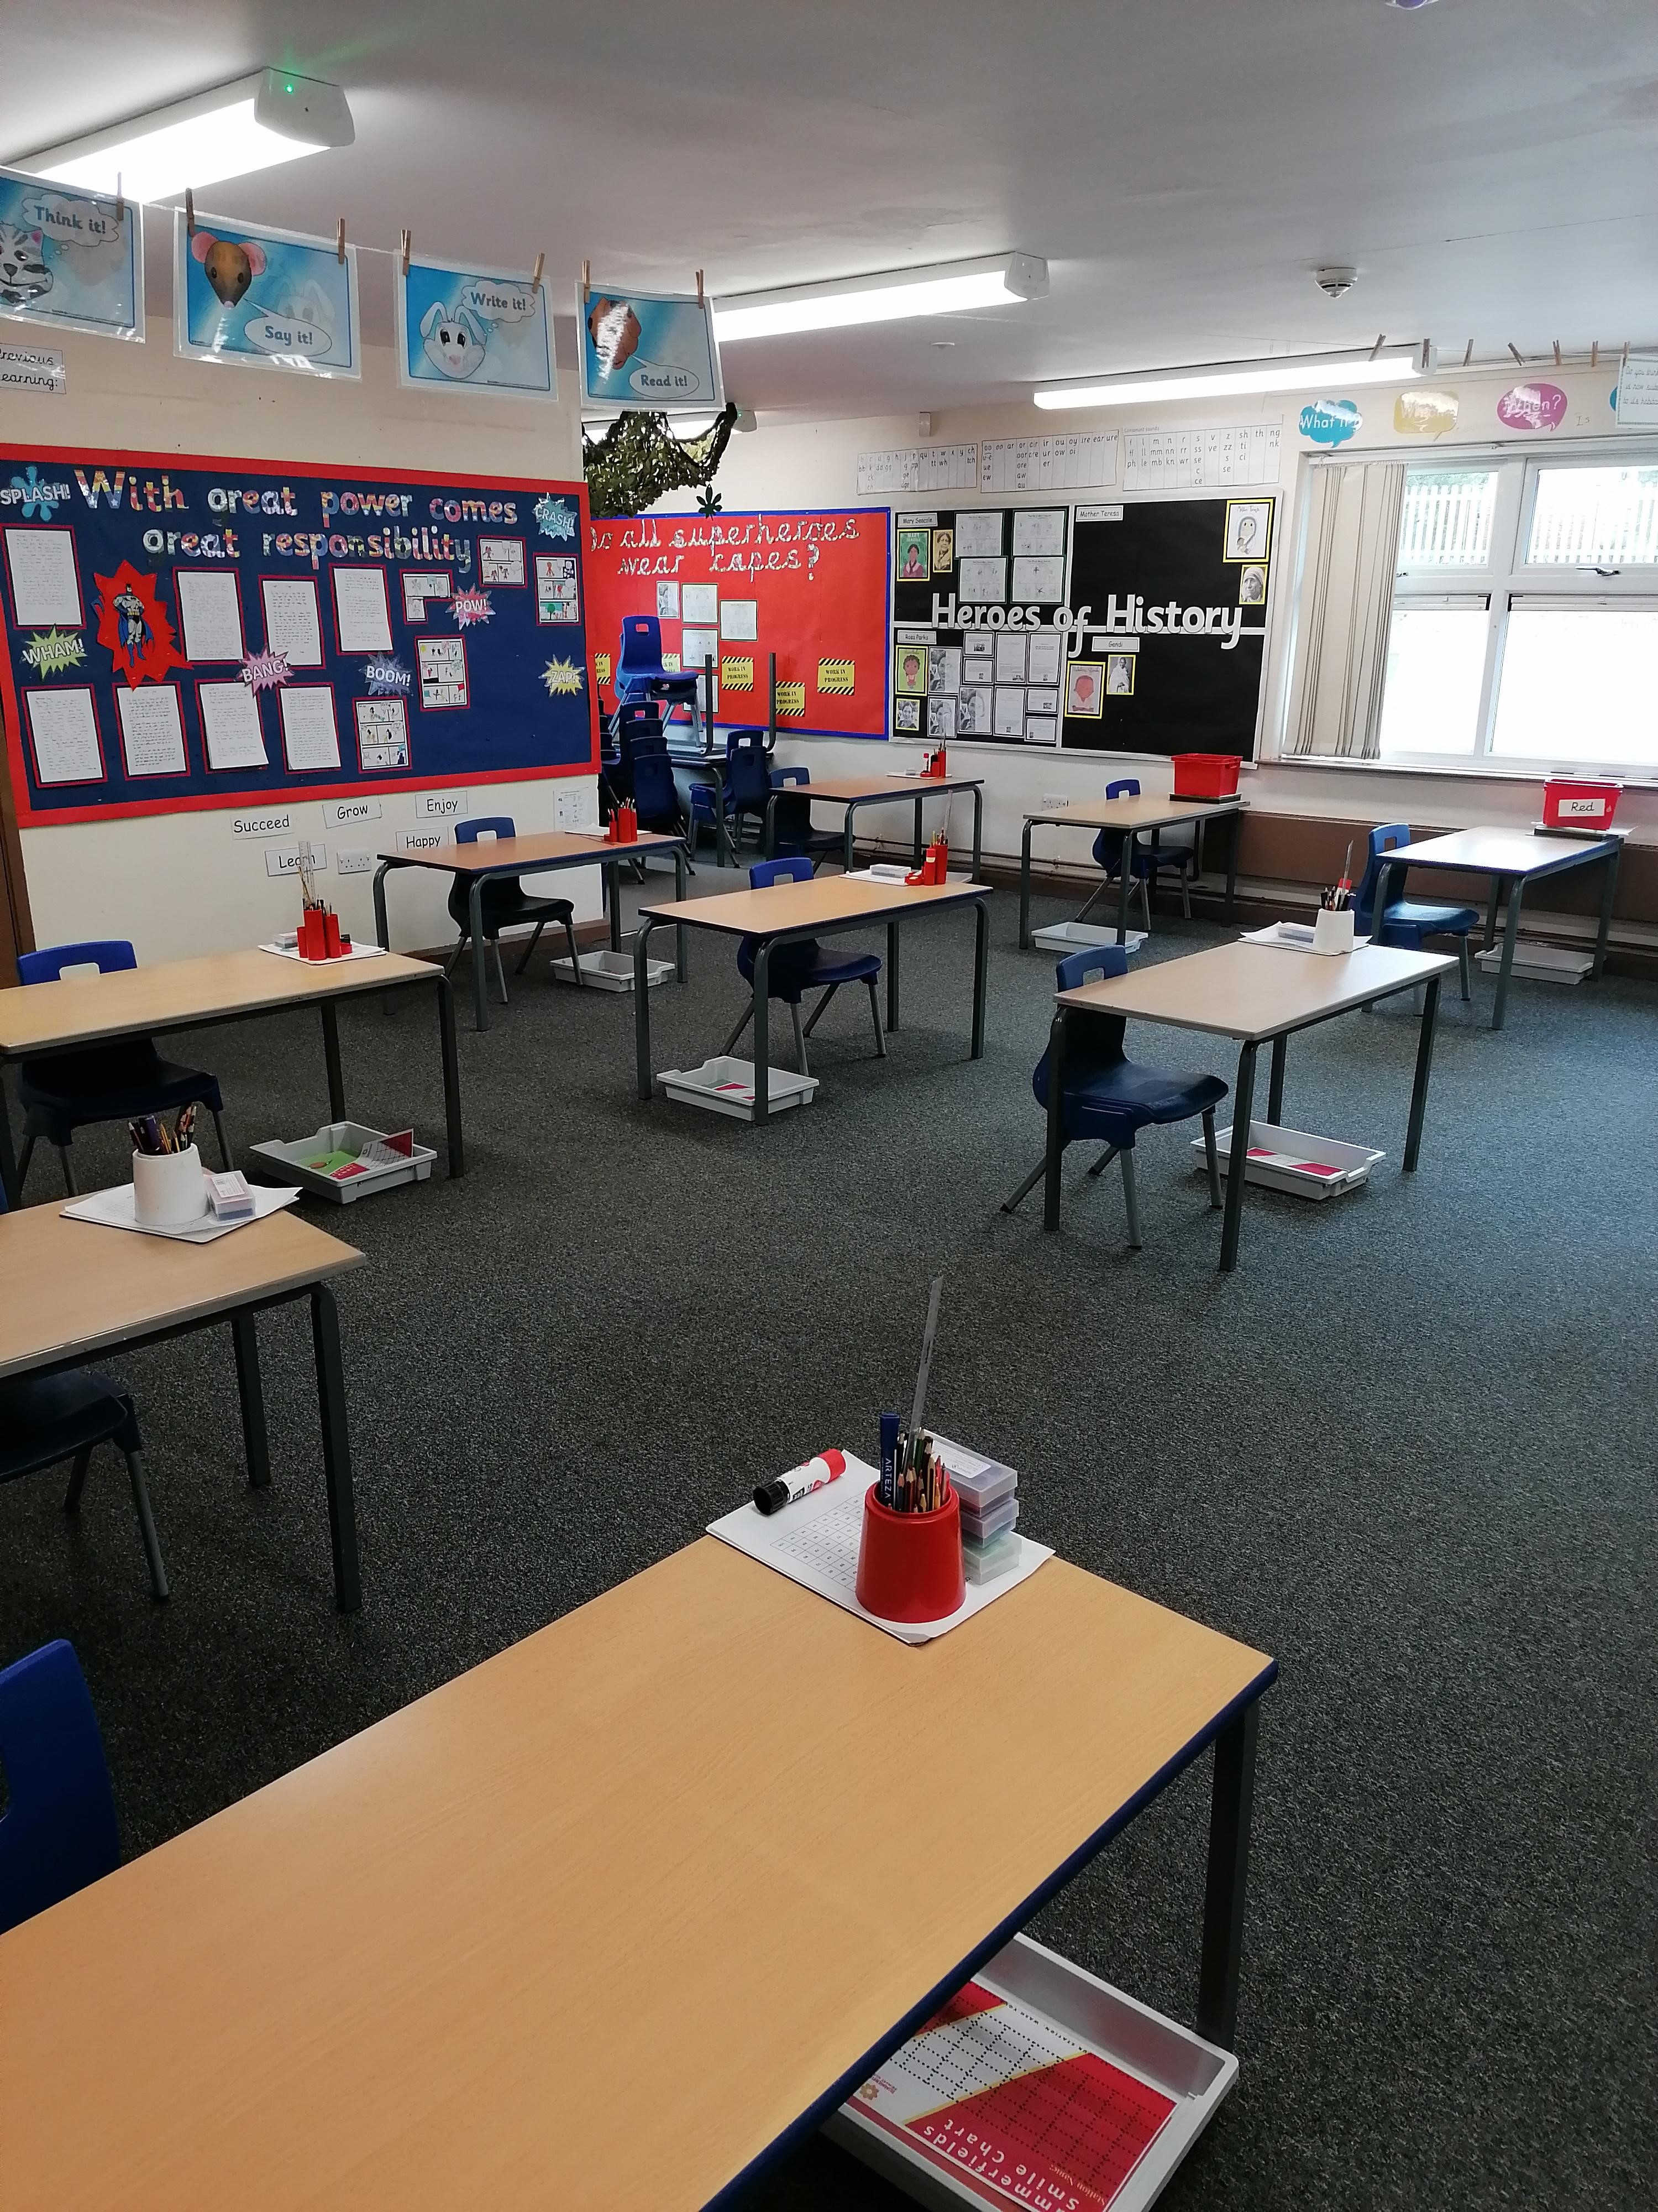
There will only be a few children in my classroom
We will not sit too close to each other as this helps us to stay safe.
I will have my own pencils and rulers in a TRAY UNDER MY DESK to look after. I will NEED TO BRING my own water bottle FROM HOME THAT WILL STAY IN MY TRAY. Lunchboxes will go in the tray too and coats will go on the back of chairs. We are not sharing our resources so we can keep each other safe.

Slide 6
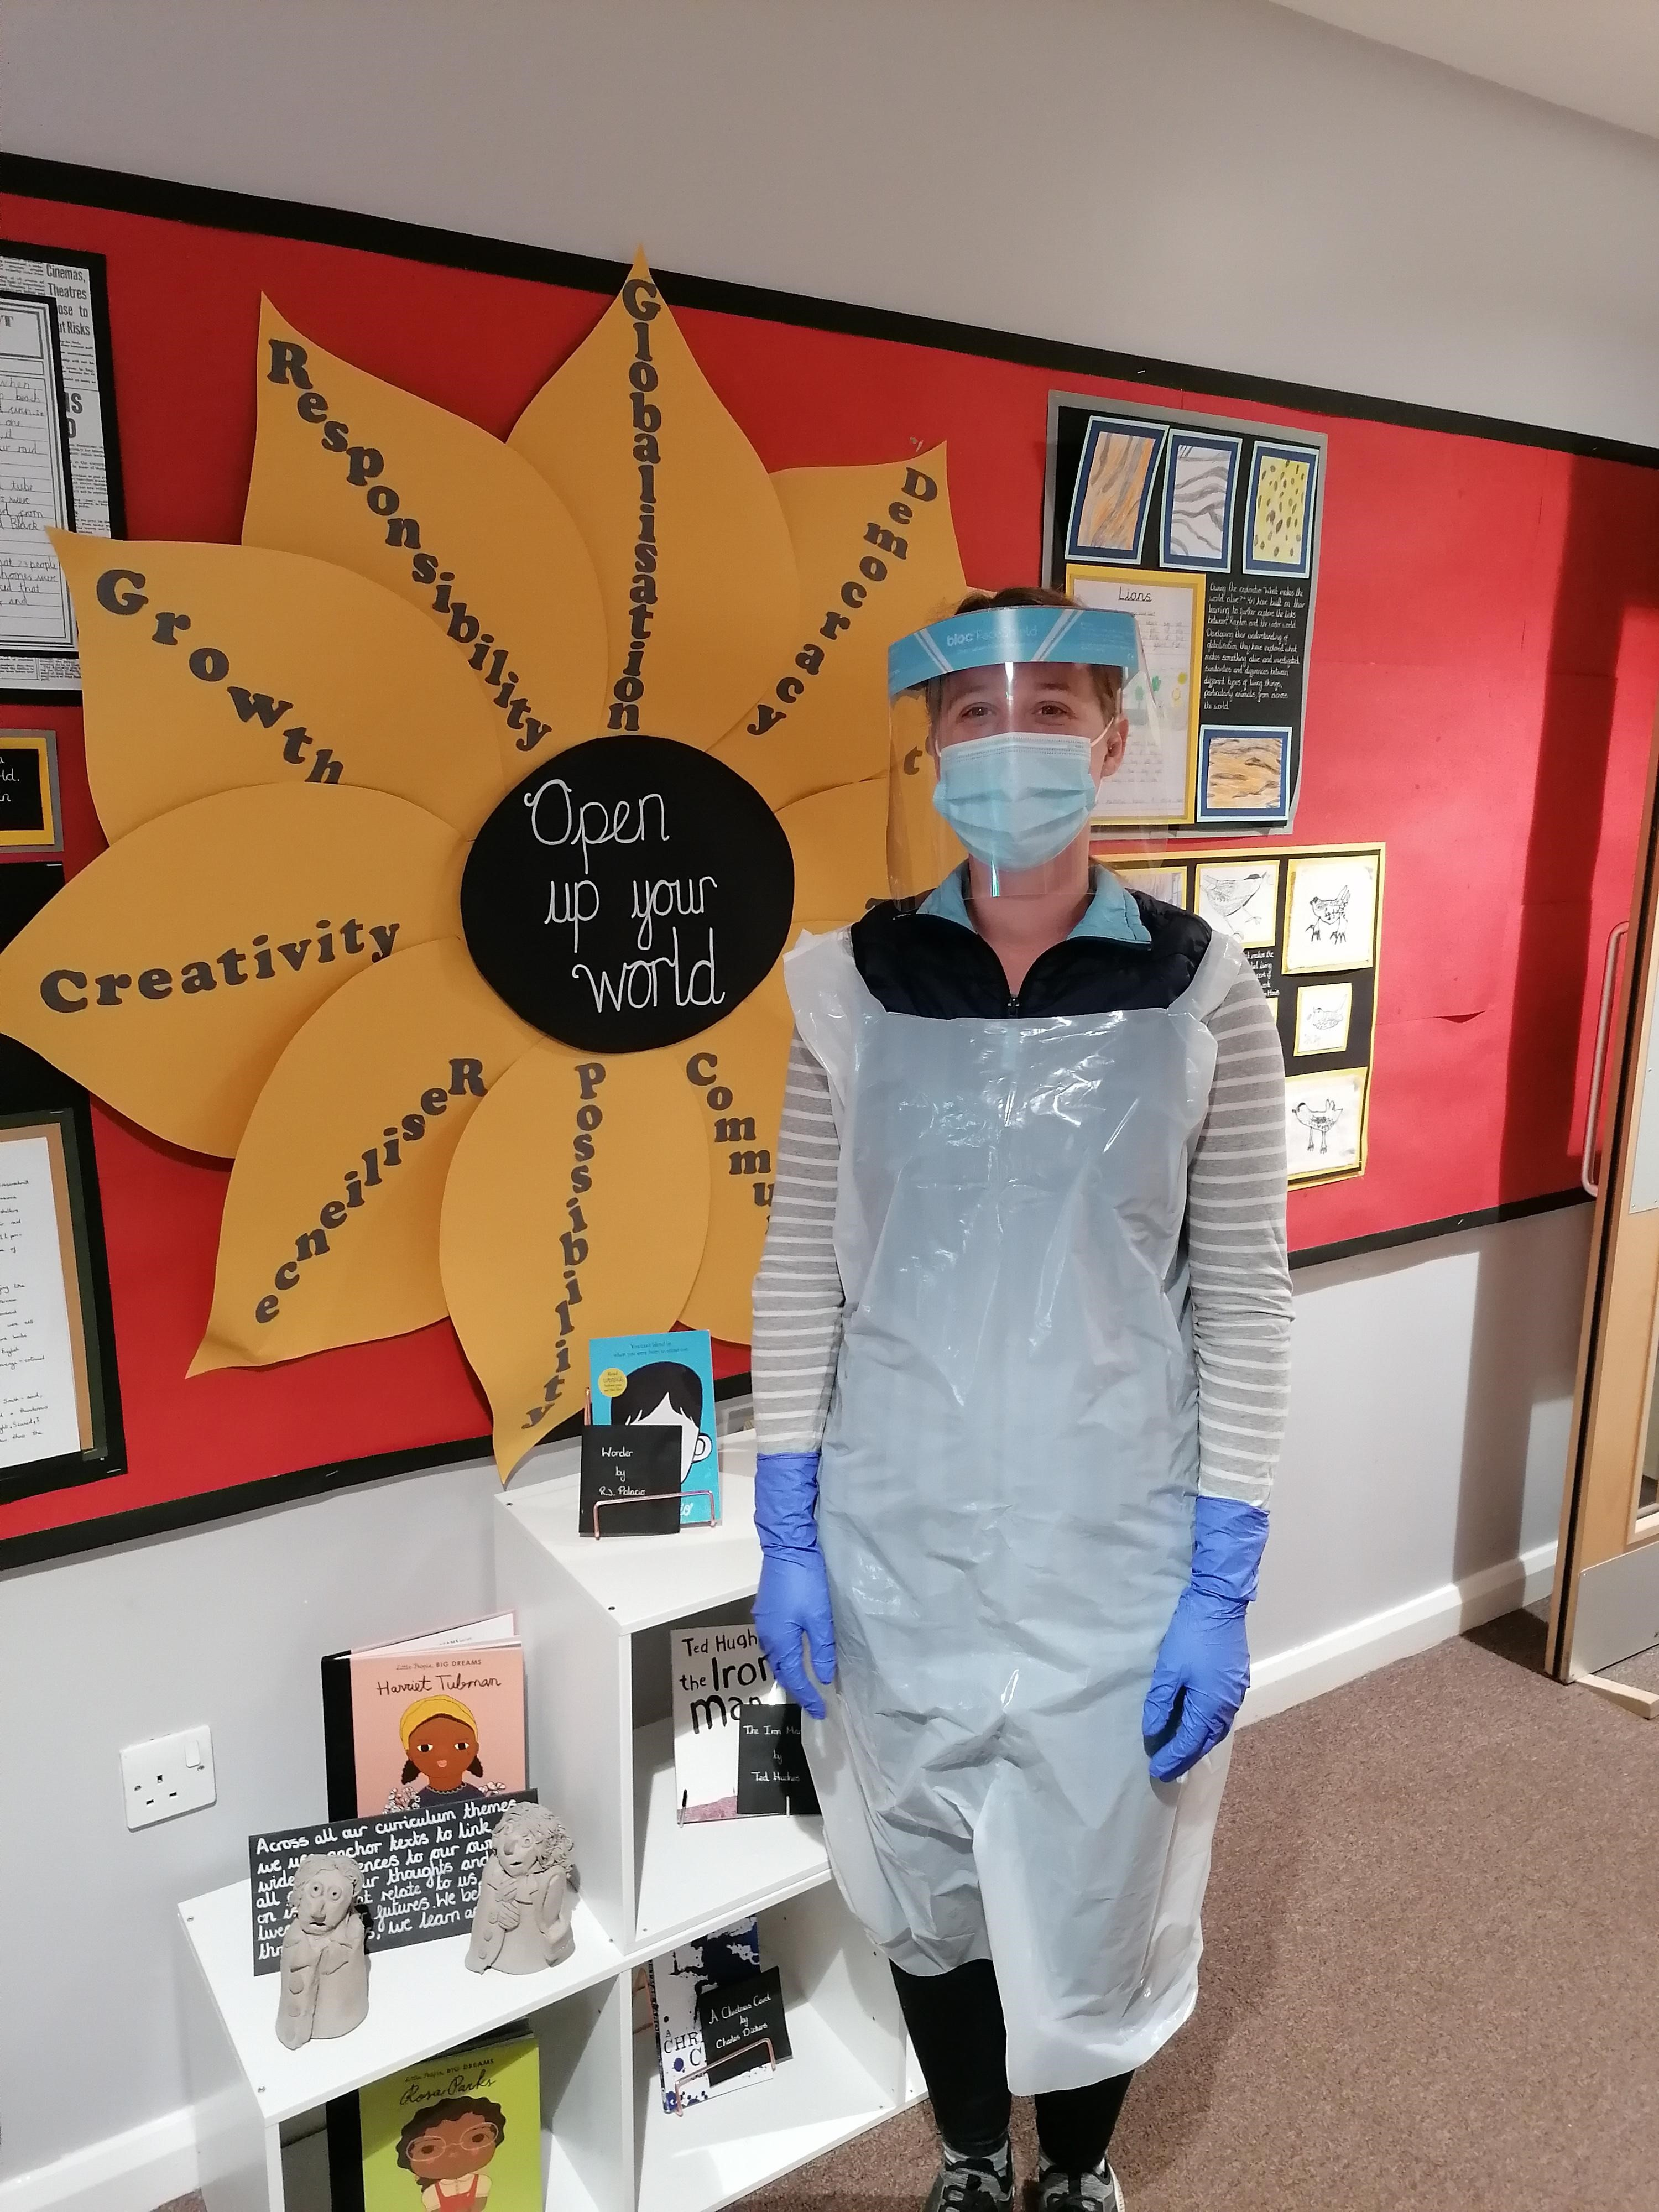

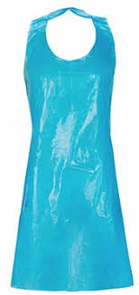
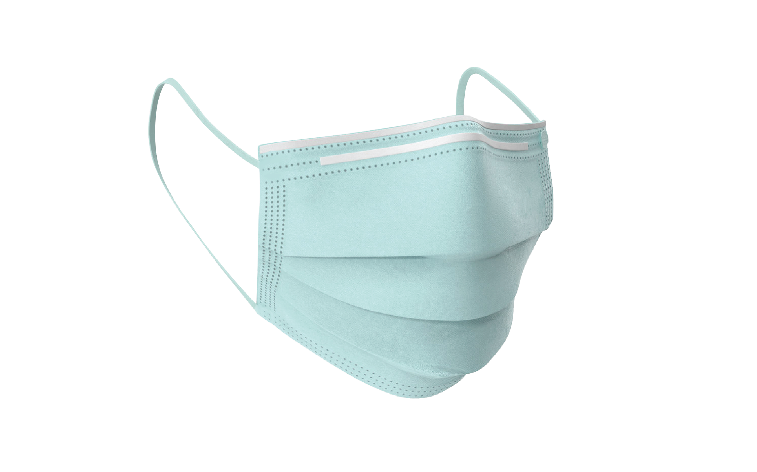
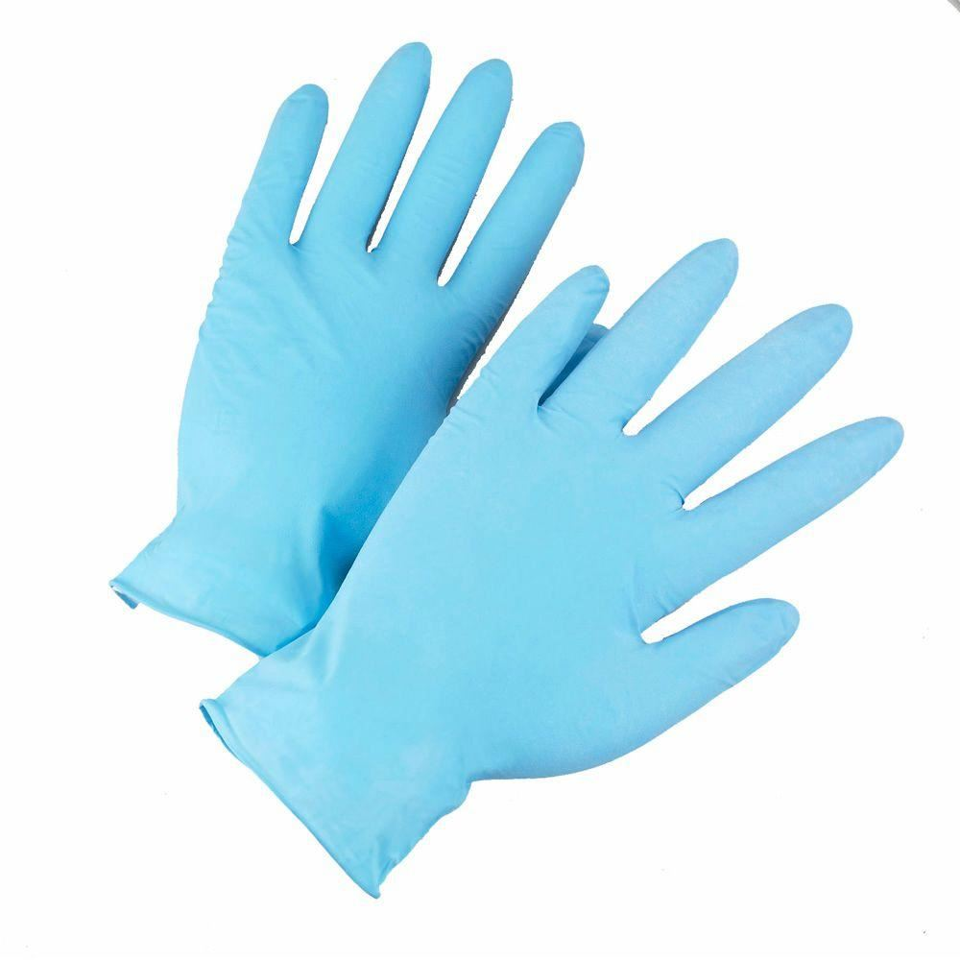
If adults have to do any first aid or look after you when you are poorly, they might have to wear some different equipment. It may look like this

Slide 7
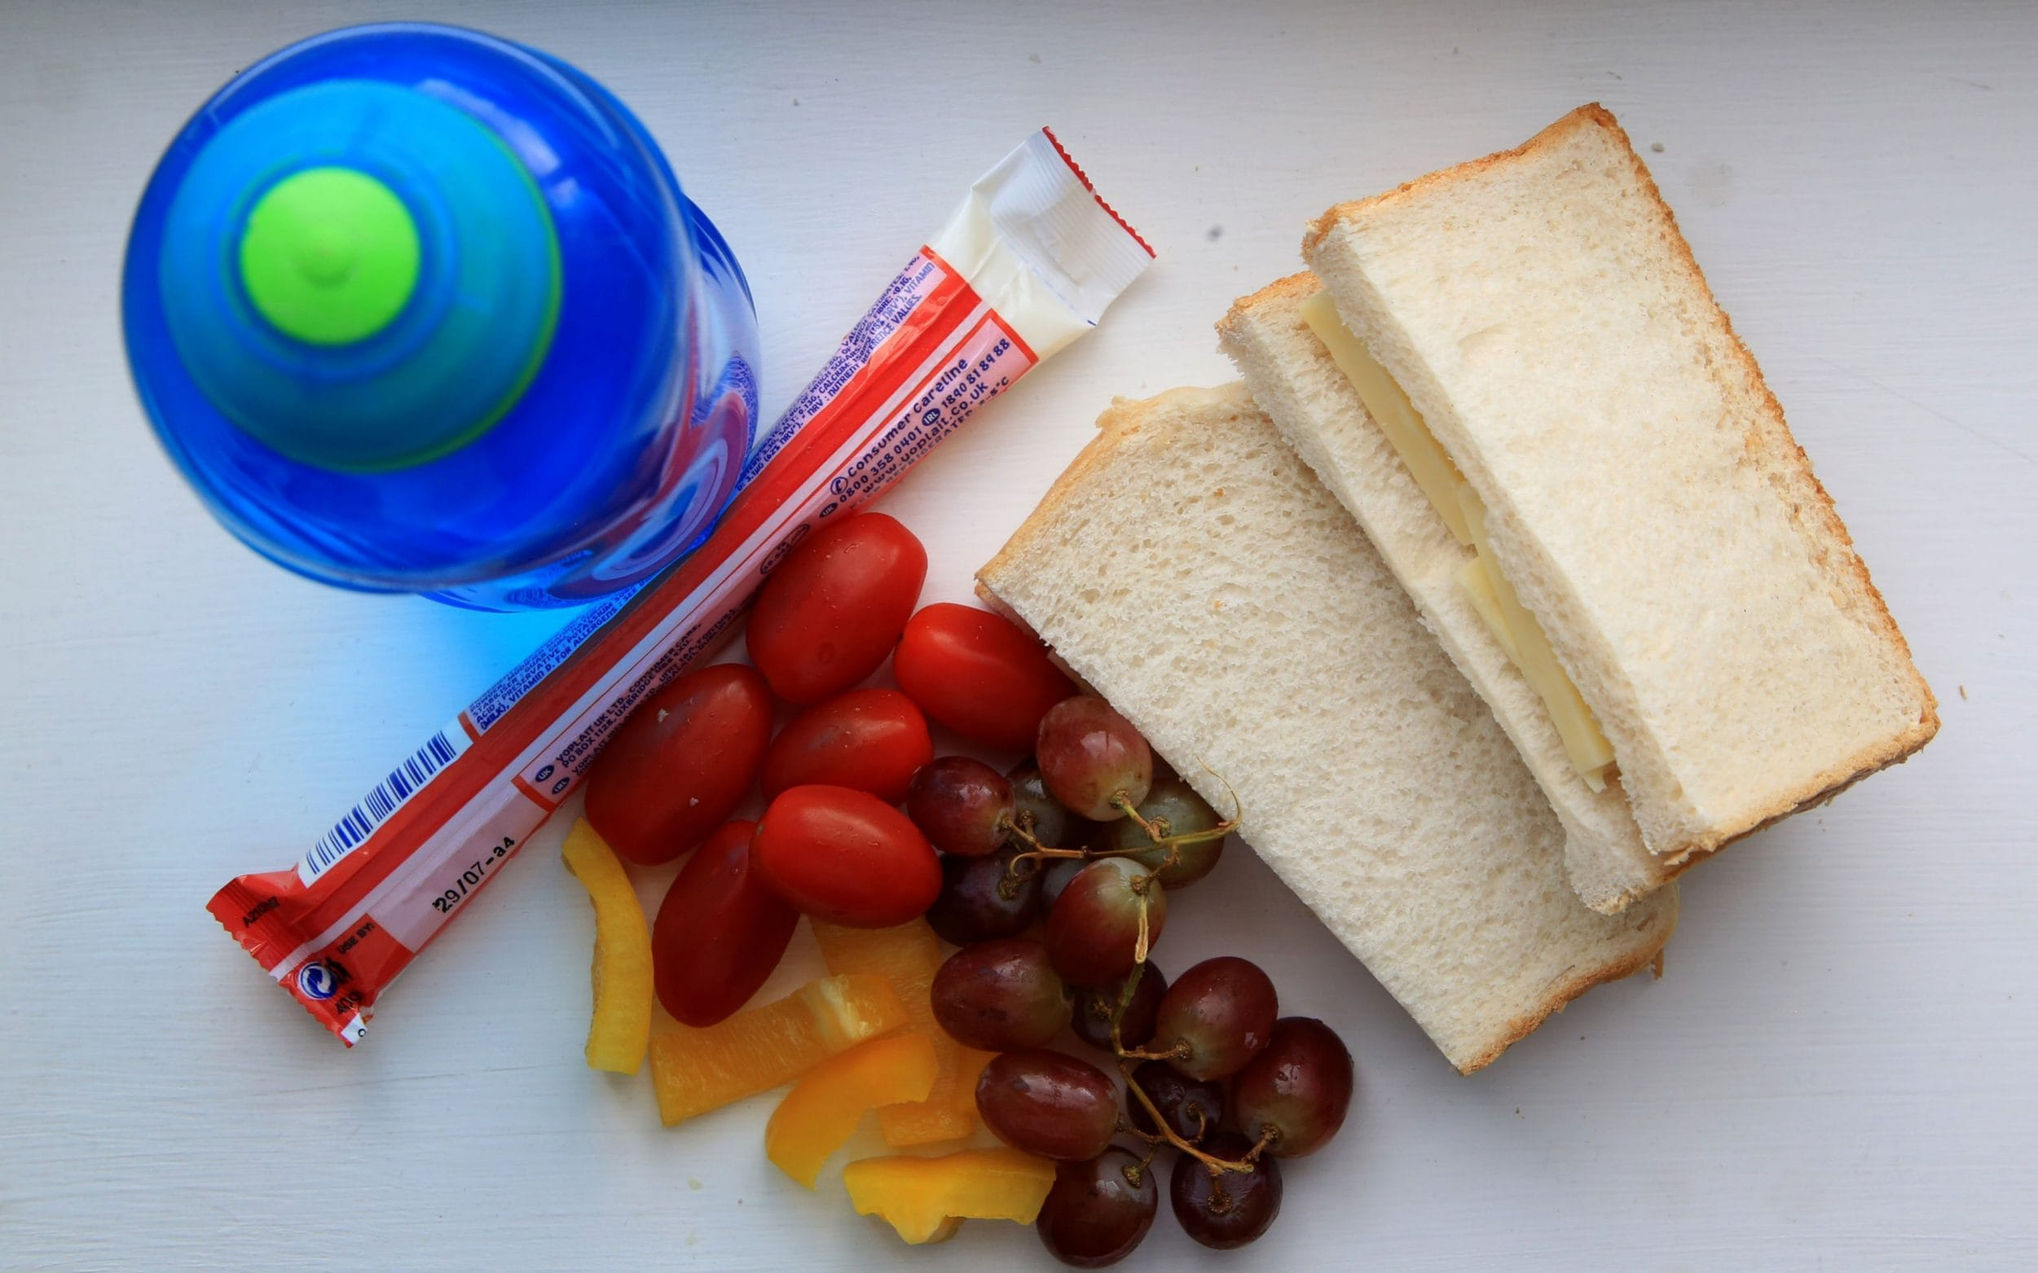
At lunchtimes, I will stay with my class friends and we can play together on our area of the playground/field.
I will eat my lunch in my classroom.
We can run around and have fun!

Slide 8

If I am not well, I will stay at home

Slide 9
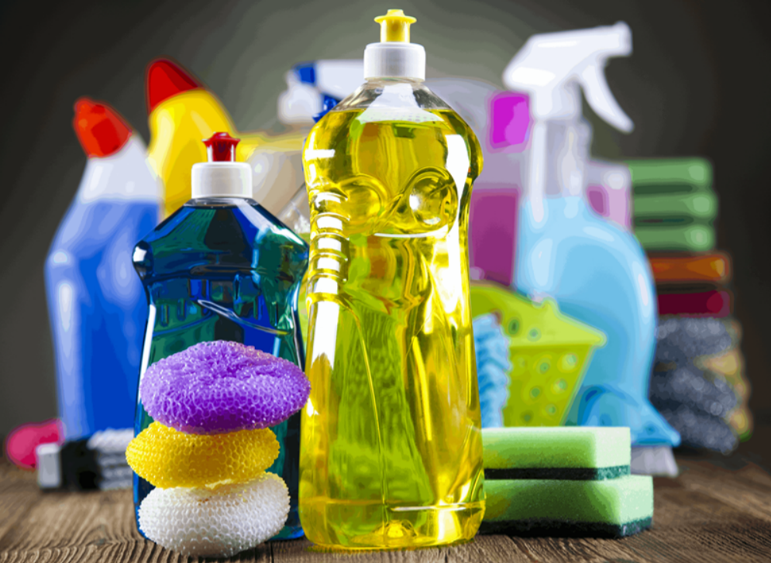
The school has been cleaned to make sure that there are no germs.
It will also be cleaned in the day after we have used something.

Slide 10
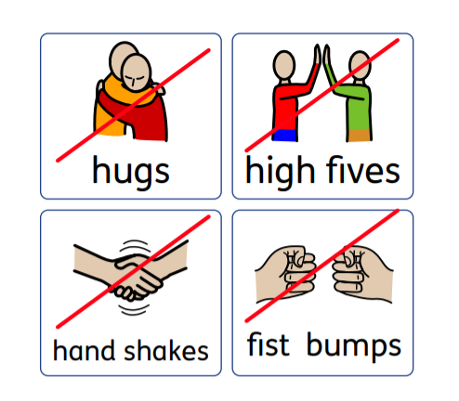
To keep safe, we are not allowed to touch each other.
We can still wave and talk to each other.

Slide 11
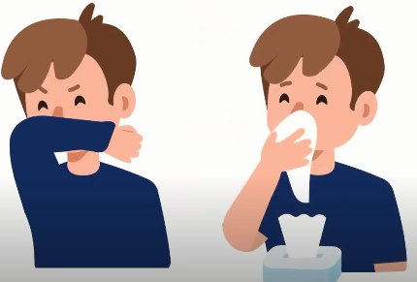
If I need to cough, I must do this away from others and into my arm or a tissue. I will Bin the tissue and wash my hands.

Slide 12

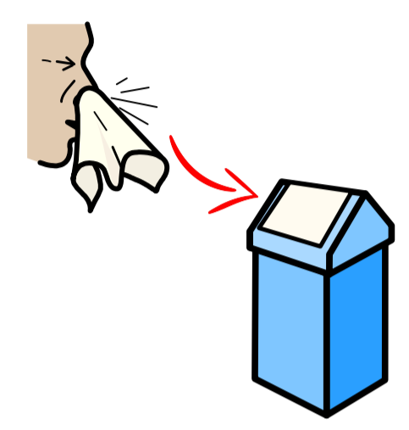

If I sneeze, I will use a tissue
Catch it
Bin it
Kill it

Slide 13

I will be safe by ……...

Slide 14
I will wash my hands every time I change activities!
Anti-bacterial hand gel is also available at all locations within school.

Slide 15
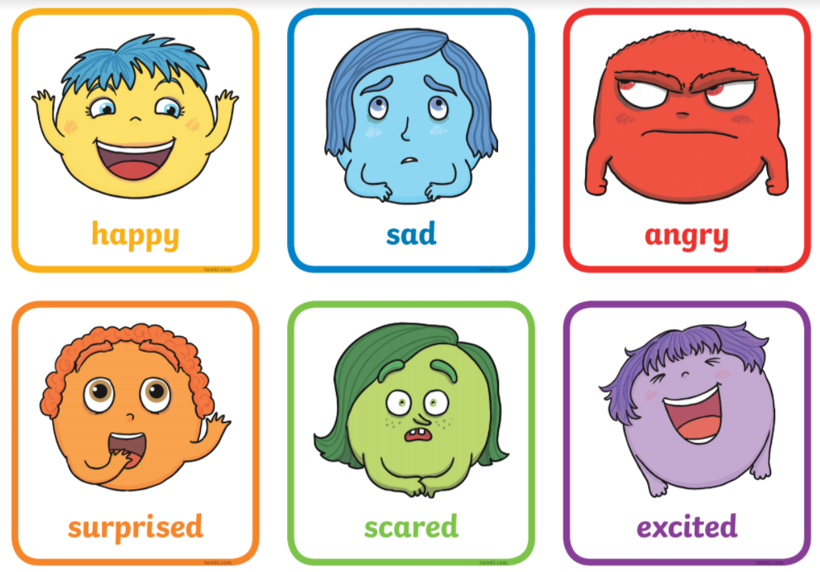
Your teachers are really looking forward to seeing you again.
How are you feeling about coming back?

