Slide 1
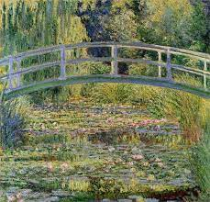
Welcome to
Monet Class
Year 4
Miss Foster, Mrs Lloyd and Miss Hunter

Slide 2
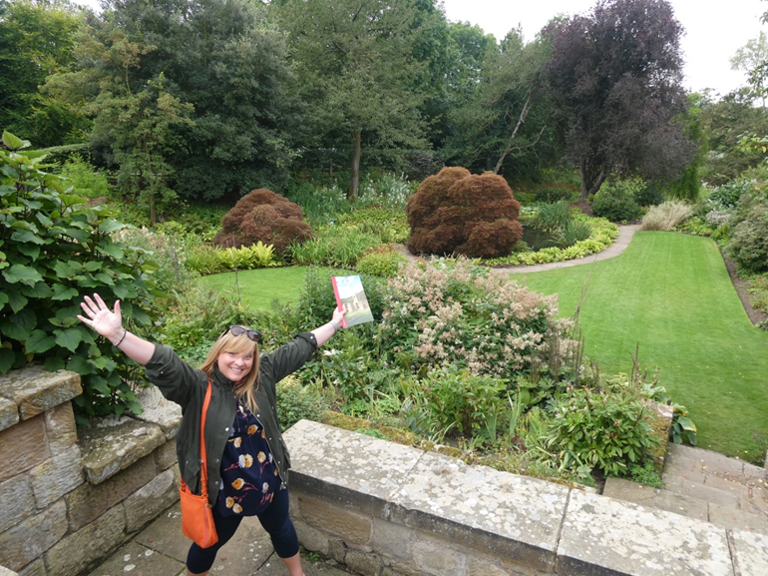

A little bit about us…
Miss Foster
Teaching since 2000 – Wakefield and Barnsley
mainly in years 3 & 4.
Love drawing and painting, going on adventures and reading.
Mrs Lloyd
TA
Miss Hunter
TA

Slide 3
Lessons
AM:
Handwriting/ spellings / Times Table Rockstars
Guided reading
English
Maths
Lunch
PM:
Explore -Science, history, geography, art, DT, IT, RE PSHE, PSHE, PE (Please could you ensure earrings are taken out and that long hair is tied up).
Y4 will have swimming lessons this year. There have been some changes to arrangements. Once these have been confirmed I shall let you know.
Music - Brass / Cornets with Mr. Francis
Assembly - Monday and Friday afternoons

Slide 4
Timetable
Our PE day is Wednesday afternoon with Mr Rawlings. Please could earrings be taken out and long hair is tied up. Red t-shirt and black shorts should be worn for PE along with black trainers; in the winter months black tracksuit bottoms if PE is to take place outside. Children can come to school in their kits as they have done this year.
Music – Wednesday 1:00 – 2:00 pm. This year, your children will be learning how to play a brass instrument with Mr Francis.

Slide 5

Dojos
We will continue to use Class Dojo next year and your child will automatically be transferred over to their new class.
Bronze 100
Silver 200
Gold 300
Platinum 500
Diamond 700
Ruby 1000
If there are any changes to the scoring system then you will be notified as soon as possible.

Slide 6
Homework
Homework will be set via a grid. We will discuss when this needs to be returned as a class in September.
Topic grids
Maths - Times Table Rockstars
Spellings – Spelling Shed
Reading – Children are expected to read to an adult, at home, three times over the course of a week.

Slide 7
Topics
Cycle 1:
Who do you think you are?
During this explore unit, we be looking at what makes a community by initially focusing on our local area. We will also learn about the steel industry in South Yorkshire and how it contributed to the economy.
Our science focus for this explore is learning about how to look after our teeth and the human digestive system.
Through art, we will be studying the art works of Picasso and Dali and how their unique styles changed the art world.

Slide 8
Reading
Children will have guided reading sessions everyday, focussing on different reading strands of Vocabulary, Inference, Prediction, Explain and Summarise.
Children will read one-to-one with an adult at least once a week.
Just like this year, children will take home the easier book band to read with you. This is to help promote enjoyment, fluency and expression with their reading. At school, they will have a book from the next band up to help increase their difficulty levels.
Children will have free choice reading books as well as banded books. The banded book will be at least 95% decodable, purely for practising fluency and sharing reading.

Slide 9
Gentle reminder - Year 4 residential to Robinwood is from the 15th - 17th November 2023.
Thank you for all your support so far and I look forward to a very exciting year ahead.
If you have any questions, please do not hesitate to contact me via Dojo and I will get back to you as soon as I can.
Many thanks,
Miss Foster

