Slide 1


Slide 2




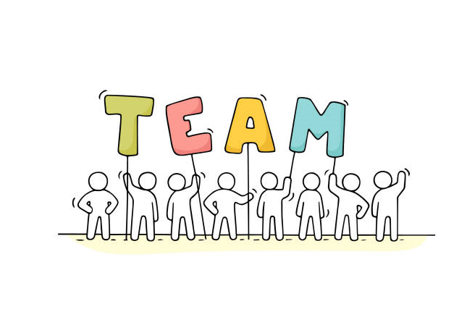
Mrs Brown
Mrs Lloyd

Slide 3

PE Kits should be brought to school on Wednesdays. This is our PE day.
PE kits will go home the same day.
9-10:15 Maths
10:15-10:30 Break Time
10:30-12:00 SPaG and Literacy
12:00-13:00 Lunch Time
13:00-14:30 Wider Curriculum (Science, Geography, Art etc)

Slide 4
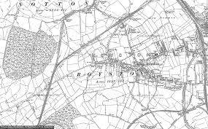
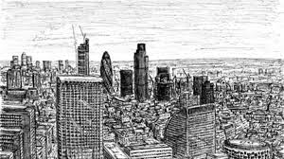
What will our typical week look like?
*Daily maths lessons.
*Daily literacy lessons, which will include our reading sessions.
*Daily SPAG sessions.
*Weekly spelling sessions – spellings will be sent home, practised in school and then tested the following week.
*Weekly Explore Lessons: This Half Term we will mainly be looking at Geography.
*Weekly Art Lessons: We are focusing on the artist Stephen Wiltshire.

Slide 5

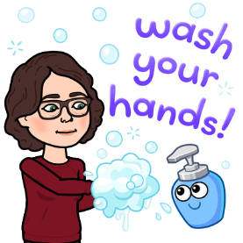



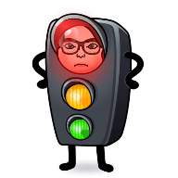
Class expectations
*Children should arrive at their allotted time slot (9am or with sibling at allotted time), having washed their hands before they have left home.
*Children’s hands will be sanitised on entry to the classroom.
*Children should come in and begin the task that they have been given on their desks.
*The school day in year 4 currently finishes at 3pm.
*Rewards for: Following our Academy rules and behaving appropriately. Rewards will also be given for positive attitudes and great work.
*Unwanted behaviour: Making poor choices, Poor attitude, Disruptive behaviour, Being disrespectful and Being rude.

Slide 6

Homework
*A grid will be stuck in homework books and planners for homework to be completed within this half term.
*Spellings will be given weekly.
*You should read to an adult or independently at least 3 times a week.
*Maths and Literacy homework will be sent out when needed.

Slide 7

*Children will be rewarded for their attitude, work and activities in and outside of school using Class Dojo.
*Parents should have received their log in details on the 3rd/4th September.
*Parents can download the app and see the achievements of their children.
*Teachers can send messages to parents and parents can respond via the app or website.
*Mrs Whitehead will reward children with a star of the day notification sent to parents on the Dojo app.

Slide 8
Communication
*Parents can write messages in planners or on Dojo. Mrs Whitehead will respond as quickly as possible.
*The Determined Dolphins class blog will soon be up and running for information and photos of the activities that we have been up to.
*The School email address is another way that you will be able to communicate with Mrs Whitehead.

Slide 9

Let’s look forward to an amazing year of Learning !

