Slide 1
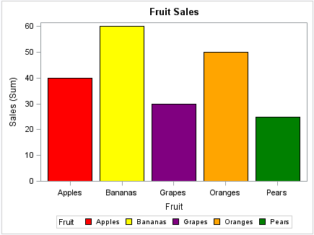
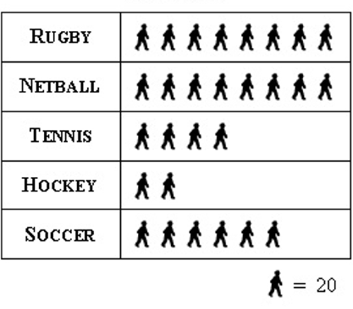
Summer 2: Week 2: Pre-Learning Task
The pre-learning task below could be used to assess pupils’ starting points within this objective. It needs to be completed by all/ or some of the pupils in advance of the main teaching.
Name |  | Summer 2: Week 2
Objective: Statistics | Solve comparison, sum and difference problems using information presented in bar charts, pictograms, tables and other graphs
Look at the bar chart below which shows the sales of different fruit on a Sunday. How many apples were sold? What is the difference between the most popular fruit and the least popular fruit? |  |  |  | Look at the pictogram below. This shows pupils’ favourite sport in a London school. How many pupils chose hockey? How many more pupils favour netball over tennis? How many prefer rugby to soccer?

Slide 2
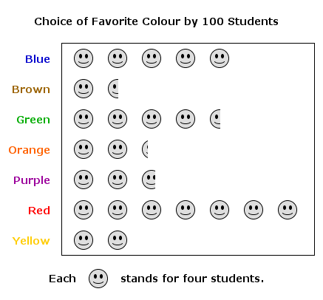
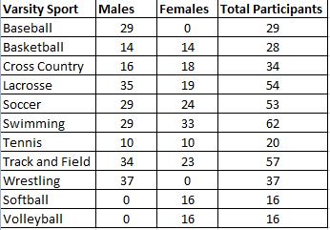
Summer 2: Week 2: Practice and Consolidation
Statistics: Solve comparison, sum and difference problems using information presented in bar charts, pictograms, tables and other graphs
Teaching Sequence | Oral and Mental Activities: Examples: | Pencil and Paper Activities Examples:
Compare information in bar charts to answer questions Solve addition problems using information in bar charts to answer questions Solve difference problems using information in bar charts to answer questions Compare information in pictograms to answer questions Solve addition problems using information in pictograms to answer questions Solve difference problems using information in pictograms to answer questions Compare information in tables to answer questions Solve addition problems using information in tables to answer questions Solve difference problems using information in tables to answer questions | Have three charts ready (could be on IWB). The three charts are a bar chart; pictogram and table giving the same information. Explain to the pupils how they differ and get them to consider which is their favourite and why. Help pupils to think of a range of questions they could ask related to the information on the charts. Take particular care to talk about the scales along the axes. |  | Look at the information on the pictogram. How many students favoured red over brown? How many students chose brown, yellow or purple? How many students chose orange? Which were the three most favoured colours, in order? Which were two least popular?
 |  |  | This table tells you about students’ favourite sports at university. Which sport was favourite? What is the difference between those that favoured lacrosse and tennis? Which sports proved to be most popular with males?
100 students chose favourite colour

Slide 3
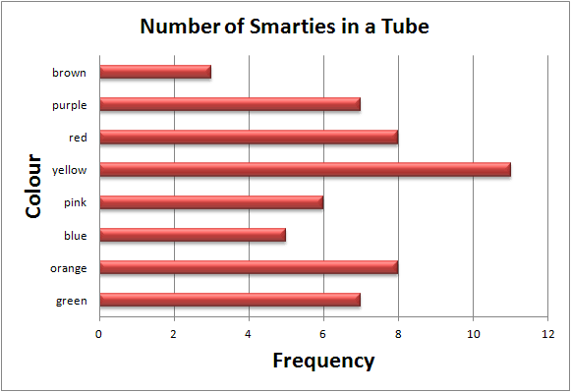
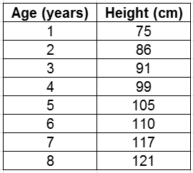
Summer 2: Week 2: Mastering this Objective – Deeper Understanding
Statistics: Solve comparison, sum and difference problems using information presented in bar charts, pictograms, tables and other graphs
Teaching Sequence | If pupils have mastered this objective they will be able to complete these activities independently:
Compare information in bar charts to answer questions Solve addition problems using information in bar charts to answer questions Solve difference problems using information in bar charts to answer questions Compare information in pictograms to answer questions Solve addition problems using information in pictograms to answer questions Solve difference problems using information in pictograms to answer questions Compare information in tables to answer questions Solve addition problems using information in tables to answer questions Solve difference problems using information in tables to answer questions
Smarties in the tube
Which colour is most frequently seen in a Smarties tube?
Is this for all Smarties tubes? How could you find out?
If you put all the yellow, red and orange Smarties together do they make up more than all the rest put together?
Do you think the bar chart would be the same if the subject was ‘The favourite Smarties colour of the children in your class’?
Height chart
What is this table telling you?
Between which two years do you grow most?
Between which two years do you grow the least?
How much do you typically grow between the ages of 1 and 7?
Thinking of height, create a table, bar chart or pictogram related to information you collect about people’s height.
Present your information in the best possible way and think of a range of questions to ask someone who looks at it.

Slide 4
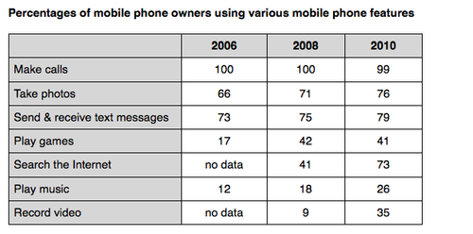
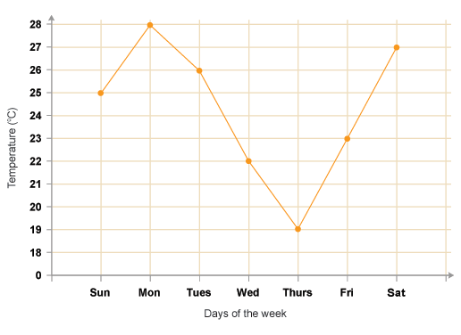
Summer 2: Week 2: Working at greater depth
Statistics: Solve comparison, sum and difference problems using information presented in bar charts, pictograms, tables and other graphs
Teaching Sequence | Activities for pupils working at greater depth:
Compare information in bar charts to answer questions Solve addition problems using information in bar charts to answer questions Solve difference problems using information in bar charts to answer questions Compare information in pictograms to answer questions Solve addition problems using information in pictograms to answer questions Solve difference problems using information in pictograms to answer questions Compare information in tables to answer questions Solve addition problems using information in tables to answer questions Solve difference problems using information in tables to answer questions | Look at the information above about how people have changed their uses of mobile phones. In 2006 and 2008 all mobile phone owners used the phones to make calls. In 2006 two-thirds of owners used the phone to take photographs. Look carefully at the information and list three things that you have learnt. Why do you think very few people seemed to play games or play music on their mobile phones in 2006? Why has the percentage using the internet shot upwards in the last few years? | What’s it all about? Look at the information contained within the graph below. What do you think is being measured? Consider that whatever is being measured is done on a daily basis for one week. Try and come up with a plausible suggestion as to what this is all about. There are no right or wrong answers but your explanation needs to fit the graph.

Slide 5
Summer 2: Week 2: Assessment
The grid below helps to identify the journey pupils make towards mastering this objective. It can be used by the teacher to keep an on-going check on progress or more likely placed in the pupils’ books so that they can keep their own checks.
Statistics: Solve comparison, sum and difference problems using information presented in bar charts, pictograms, tables and other graphs |  |  |  |  |  |  |  | Me | My Teacher
 | Can you solve problems in relation to bar charts, pictograms or tables?
 |  | Can you answer questions related to sum or difference in relation to bar charts, pictograms or tables?
 |  |  | Can you read a table accurately?
 |  |  |  | Can you read a pictogram accurately with scales on the axes?
 |  |  |  |  | Can you read a pictogram accurately with no scales on the axes?
 |  |  |  |  |  | Can you read a bar chart accurately with scales on the axes?
 |  |  |  |  |  |  | Can you read a bar chart accurately with no scales on the axes?

