Slide 1
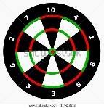

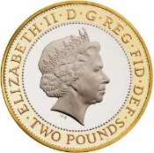
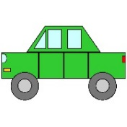


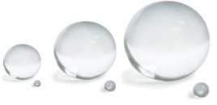
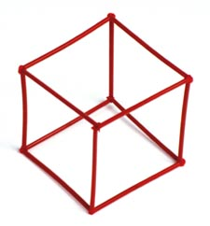
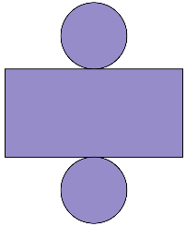
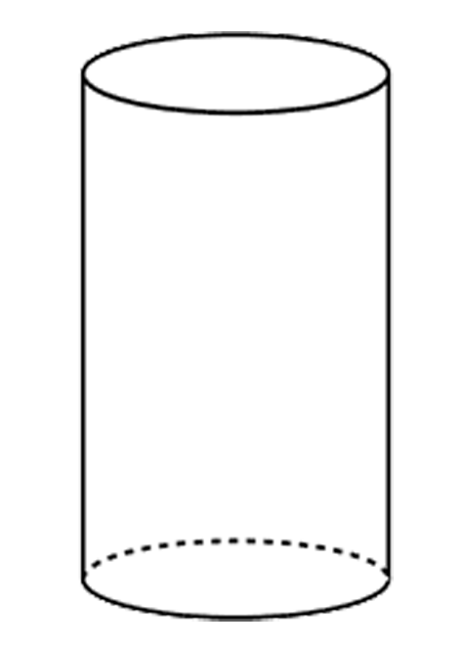
Summer 1: Week 6: Pre-Learning Task
The pre-learning task below could be used to assess pupils’ starting points within this objective. It needs to be completed by all/ or some of the pupils in advance of the main teaching.
Name |  | Summer 1 Week 6
Objective: Geometry | 2D and 3D Shapes: Compare and sort common 2D and 3D shapes and everyday objects.
These items have circles.
Find more items that have a circle in them.
These items are spherical.
Find more items that are spherical.
What are the differences and similarities between a cube and a square?
Explain using geometric language.
Look at the net for a cylinder and the cylinder above. Describe some differences and similarities between them.

Slide 2
Summer 1: Week 6: Practice and Consolidation
Geometry: 2D and 3D Shapes: Compare and sort common 2D and 3D shapes and everyday objects.
Teaching Sequence | Oral and Mental Activities Examples: | Pencil and Paper Activities Examples:
Compare and sort a set of triangles and pyramids, recognising their similarities and differences Gather a set of rectangles and cuboids, recognising their similarities and differences Gather a set of circles and spheres, recognising their similarities and differences | Look closely at a range of 3D shapes. Start with a cube and cuboid and consider the 2D shapes that make up each of the 3D shapes looked at. Remind pupils of where they can find examples of the 3D shapes looked at in the outside environment, pointing out that some of the shapes are chosen for a range of properties that they have, e.g. strength of triangles and pyramids Look at the properties of 3D and 2D shapes and use correct geometrical language when doing so. | Look at the following triangles and consider their similarities and differences: Name 2 similarities and 2 differences. Now do the same with cuboids.
 |  | Look at the following 3D cuboid shapes. Consider their similarities and differences:
 |  | Find as many cuboids; cylinders; cubes; spheres and pyramids as you can that we use everyday. Start by thinking of sweet containers. Some are very well known.

Slide 3
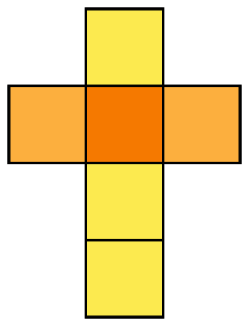
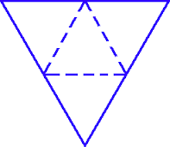
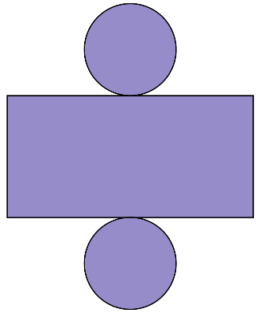
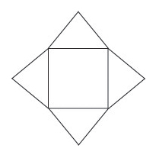
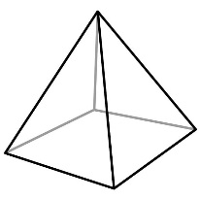

Summer 1: Week 6: Mastering this Objective - Deeper Understanding
Geometry: 2D and 3D Shapes: Compare and sort common 2D and 3D shapes and everyday objects.
Teaching Sequence | If pupils have mastered this objective they will be able to complete these activities independently:
Compare and sort a set of triangles and pyramids, recognising their similarities and differences Gather a set of rectangles and cuboids, recognising their similarities and differences Gather a set of circles and spheres, recognising their similarities and differences |  | Describe a net to your friend and see if they are able to follow your instructions. Swap tasks so that your friend describes a net to you.
 |  | Describe the similarities and differences between these 2D and 3D shapes:
Look at the nets of the 3D shapes above.
Describe how they are made up in terms of their 2D shapes.
Square-based pyramid triangle
Sphere circle

Slide 4
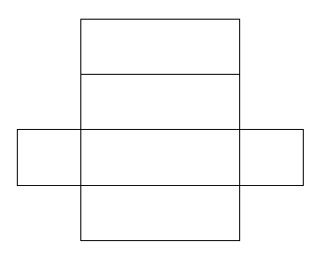
Summer 1: Week 6: Working at greater depth
Geometry: 2D and 3D Shapes: Compare and sort common 2D and 3D shapes and everyday objects.
Teaching Sequence | Activities for pupils working at greater depth:
Compare and sort a set of triangles and pyramids, recognising their similarities and differences Gather a set of rectangles and cuboids, recognising their similarities and differences Gather a set of circles and spheres, recognising their similarities and differences
 | Think of 5 different uses for a cube and a cuboid. | Using cubes, cuboids, spheres, cylinders, square-based pyramids and triangular-based pyramids, create a model. Try to make the model as interesting as possible. Record the model in your maths book and state which shapes you have used. Challenge your friend to create a model with a specific number of shapes that you give them. Photograph your models and place them into your maths books.
Look at the net of a cube.
Try and make one up and join together using sticky tape.
Make it into a dice but check how the numbers opposite each other always add up to 7
Look at how a net of a cuboid works.
Try making your own.
Design it as a sweet that you have just created and decorate your cuboid accordingly.
Cube | Cuboid

Slide 5
Summer 1: Week 6: Assessment (as Spring 1: Week 3)
The grid below helps to identify the journey pupils make towards mastering this objective. It can be used by the teacher to keep an on-going check on progress or more likely placed in the pupils’ books so that they can keep their own checks.
Geometry: Shapes: Identify 2D shapes on the surface of 3D shapes. |  |  |  |  |  | Me | My Teacher
 | Can you appreciate why certain shapes are used for everyday things, e.g. bricks for building walls?
 |  | Can you identify the 3D shapes: cube, cuboid, square-based pyramid; triangular-based pyramid, sphere and cylinder in the indoor and outdoor environment?.
 |  |  | Can you identify the 2D shapes that make up: cube, cuboid, square-based pyramid; triangular-based pyramid, sphere and cylinder?
 |  |  |  | Can you identify and name the common 3D shapes: cube, cuboid, square-based pyramid; triangular-based pyramid, sphere and cylinder?
 |  |  |  |  | Can you identify and name the common 2D shapes: circle, triangle, rectangle and square?

Slide 6
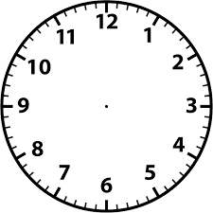
Summer 2: Week 1: Pre-Learning Task
The pre-learning task below could be used to assess pupils’ starting points within this objective. It needs to be completed by all/ or some of the pupils in advance of the main teaching.
Name |  | Summer 2 Week 1
Objective: Measures | Time: Compare and sequence intervals of time.
Using the terms: morning; afternoon; evening and night, show when these events are most likely to happen: Breakfast Bed Time Do homework Moon is out Sun rises Hottest time of day Have tea/ supper |  |  |  | Use the terms earlier or later to fill in the blanks: In the week Tuesday is __________ than Thursday. In the year Easter comes __________ than the summer holidays. School finishes ______________ than lunchtime.
Link the event with the time: 12.00 noon Get home from school 4.00 in the afternoon go to bed 10.00 in the morning have lunch 8.00 at night do maths |  |  |  | Put in the correct time: Ten past three twenty to four

Slide 7

Summer 2: Week 1: Practice and Consolidation
Measures: Time: Compare and sequence intervals of time.
Teaching Sequence | Oral and Mental Activities Examples: | Pencil and Paper Activities Examples:
Sequence events in a given day using appropriate time language, i.e. morning, afternoon, evening, night, earlier and later Order a given number of time events to the given hour or half an hour Work out longest and shortest interval of times to the given hour Revise telling the time to 5 minute intervals | Revise previous work done on time, reminding pupils of the five minute intervals and appropriate use of terminology. Consider the things that happen in morning; afternoon, evening and night time. Build a picture of the things that typically happen at these times. Use terms like ‘ one hour later’ and ‘one hour earlier’. Get pupils to think about time intervals during a typical day, e.g. arrive at school and going home from school. | Put in the time on clock faces: 10 past 5 25 to 7 20 to 8 5 past 3
 |  | Working out what the time is on clock faces:
 |  | Name 3 things that happen typically in the morning. Name 3 things that happen typically in the afternoon. Name 3 things that happen typically in the evening. Name 3 things that happen typically at night.
 |  | If I arrive at school at 8 in the morning and I have lunch at 12 noon, how much time has passed between arriving and lunch? I wake up at 7 in the morning and I go to bed at 8 at night. How much time has passed between getting up and going to bed?

Slide 8
Summer 2: Week 1: Mastering this Objective - Deeper Understanding
Measures: Time: Compare and sequence intervals of time.
Teaching Sequence | If pupils have mastered this objective they will be able to complete these activities independently:
Sequence events in a given day using appropriate time language, i.e. morning, afternoon, evening, night, earlier and later Order a given number of time events to the given hour or half an hour Work out longest and shortest interval of times to the given hour Revise telling the time to 5 minute intervals | TV Programme The time is 2.30 in the afternoon. Scarlet says there are 2 hours to wait before her favourite TV programme starts. What time does her favourite programme start? A film lasts for two and a half hours. It started at quarter to six, what time will it finish? Draw two clock faces to show start and finish time. | True or False It is four o’clock and it will be half past five in 1 and a half hours. True or False? It is six o’clock and it was half past three an hour and a half ago. True or False? It is 1 o’clock and it will be 3 o’clock in 2 hours’ time. True or False?
 | Clock faces Use clock faces to show what the time will be forty minutes past the times given below: Twenty-five past Four Ten past Seven Quarter past Seven Twenty to Eleven Twenty-five past Eleven | Swimming Lesson Jay and Sam both swim at the town pool. It takes Sam 30 minutes to get to the pool and it takes Jay 45 minutes to get there. It takes both 15 minutes to change and get ready to swim. At what time do both have to leave their houses if the lesson starts at 5.30?

Slide 9
Summer 2: Week 1: Working at greater depth
Measures: Time: Compare and sequence intervals of time.
Teaching Sequence | Activities for pupils working at greater depth:
Sequence events in a given day using appropriate time language, i.e. morning, afternoon, evening, night, earlier and later Order a given number of time events to the given hour or half an hour Work out longest and shortest interval of times to the given hour Revise telling the time to 5 minute intervals | True or False It is quarter past four and it will be quarter to six in 1 and a half hours. True or False? It is ten past six and it was twenty to four an hour and a half ago. True or False? It is twenty past three and it will be ten past five in 2 hours’ time. True or False? | Journey to Grandma Harry visits his Grandma 3 times each week. On Monday his journey took 20 minutes. He was 3 minutes slower on Wednesday. He did the journey on Friday in 15 minutes. On which day did his journey take the least amount of time? What was the difference in time between his Wednesday and Friday journey?
 | Playing Football Rose, Jim and Harry all play football for the local team. They all walk to the ground each Saturday morning. It takes Rose the longest to walk as she lives furthest away. It takes Jim 15 minutes less than Rose to walk to the ground. It takes Harry only 10 minutes to get to the ground, which is 10 minutes less than Jim. How long does it take Rose to walk to the ground? | The Party A class party is taking place on Saturday on at 12 noon. Henry will be taken by car and it will take him 45 minutes to get to the party. Sally will have to walk but it will only take her 10 minutes to get there. Javed will catch a bus and he will have to leave home 55 minutes before the party starts. At what time will each person have to leave to get to the party on time?

Slide 10
Summer 2: Week 1: Assessment ( as with Spring 2 Week 5)
The grid below helps to identify the journey pupils make towards mastering this objective. It can be used by the teacher to keep an on-going check on progress or more likely placed in the pupils’ books so that they can keep their own checks.
Measures: Time: Tell and write the time to five minutes, including quarter past/to the hour and draw the hands on a clock face to show these times. |  |  |  |  |  |  | Me | My Teacher
 | Can you tell what the time will be five minutes later or what the time was five minutes earlier?
 |  | Can you draw times on clock faces to the intervals of o’clock, half past, quarter past and quarter to the hour?
 |  |  | Can you read the clock to five minute intervals to the hour?
 |  |  |  | Can you read the clock in five minute intervals past the hour?
 |  |  |  |  | Can you read the clock to quarter past and quarter to?
 |  |  |  |  |  | Can you read the clock to o’clock and half past?

